Slide 1
PSC

Slide 2
Machine learning models accurately interpret liver histology and are associated with disease progression in patients with primary sclerosing cholangitis
Nathaniel Travis,¹ Vincent Billaut,¹ Harsha Pokkalla,¹ Kishalve Pethia,¹ Oscar Carrasco-Zevallos,¹ Benjamin Glass,¹ Amaro Taylor-Weiner,¹ Christopher L. Bowlus,² Atsushi Tanaka,³ Douglas Thorburn,⁴ Xiaomin Lu,⁵ Ryan Huss,⁵ Chuhan Chung,⁵ G. Mani Subramanian,⁵ Robert P. Myers,⁵ Andrew J. Muir,⁶ Kris V. Kowdley,⁷ Zachary Goodman,⁸ Aditya Khosla,¹ Andrew Beck,¹ Murray Resnick,¹ Ilan Wapinski,¹ Michael H. Trauner,⁹ Cynthia Levy¹⁰
¹PathAI, Inc., Boston, Massachusetts, USA; ²University of California, Davis, USA; ³Teikyo University School of Medicine, Tokyo, Japan; ⁴UCL Institute for Liver & Digestive Health, Royal Free Hospital, London, UK; ⁵Gilead Sciences, Inc., Foster City, California; ⁶Duke Clinical Research Institute, Durham, North Carolina, USA; ⁷Inova Fairfax Hospital, Falls Church, Virginia, USA; ⁸Liver Institute Northwest, Seattle, Washington, USA; ⁹Medical University of Vienna, Austria; ¹⁰University of Miami, Coral Gables, Florida, USA

Slide 3
Introduction
Primary sclerosing cholangitis (PSC) is a chronic fibrosing cholangiopathy marked by heterogeneous clinical presentation
Fibrosis progression is the primary histologic endpoint in two Phase 3 clinical trials of PSC (ClinicalTrials.gov NCT03872921 and NCT03890120)
Current histologic staging systems for PSC, including the Nakanuma classification, are predictive of clinical events, but have only fair interobserver agreement and may require specialized staining procedures
Variability in histologic evaluation in patients with PSC may hinder disease staging and confound clinical trial results

Slide 4
Objectives
To develop machine learning (ML) models for evaluation of liver histology in PSC
To determine associations between ML-based histologic parameters and noninvasive markers of fibrosis, cholestasis, and clinical events

Slide 5
Methods
Study Population and Assessments
Patients with PSC (N=141) from a 96-wk, Phase 2 study of simtuzumab, a monoclonal antibody directed against lysyl oxidase-like-2 (NCT01672853)
Fibrosis was staged at baseline, and Weeks 48 and 96 by a central pathologist (CP) according to Ishak classification using trichrome (TC)–stained slides
Other assessments:
Liver biochemistry tests (serum alkaline phosphatase [ALP], alanine aminotransferase [ALT], and γ-glutamyltransferase [GGT])
Enhanced Liver Fibrosis (ELF™ [Siemens Healthcare GmbH, Erlangen, Germany]) score

Slide 6
Methods
Machine Learning Assessment of Histology
An ML platform (PathAI, Inc., Boston, Massachusetts, USA) based on an annotation-based platform and convolutional neural networks (CNNs; >20 layers and 8 million parameters) developed for nonalcoholic steatohepatitis4 was used to assess PSC histology
The annotation-based platform was trained using 44,000 annotations (eg, fibrosis, lobular/portal/interface inflammation, and bile ducts/ductules) from 29 board-certified pathologists on images from 252 hematoxylin and eosin (H&E)–, 254 TC-, and 330 picrosirius red (PSR)–stained slides; the model was trained to recognize and summarize these features at the whole-slide level
CNNs were deployed on images of TC- and PSR-stained slides using slide-level Ishak stages to recognize patterns associated with each fibrosis stage; these region-based scores were used to generate a slide-level ML Ishak fibrosis score

Slide 7
Methods
Statistical Analyses
Correlations between slide-level score and CP-derived fibrosis stage were evaluated on test images excluded from model training (77 TC and 88 PSR), and associations between ML-derived features with clinical parameters, PSC-related events (eg, decompensation, cholangitis, and transplantation), and progression to cirrhosis at Weeks 48 and/or 96 were determined

Slide 8
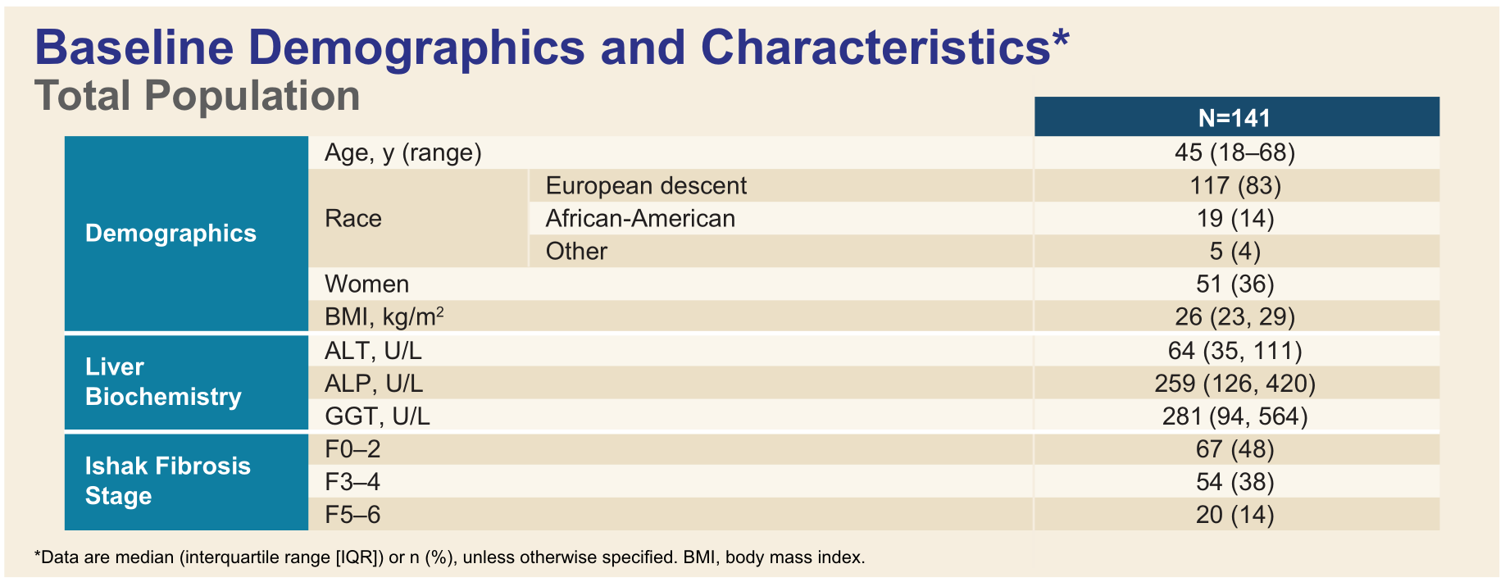
Results

Slide 10
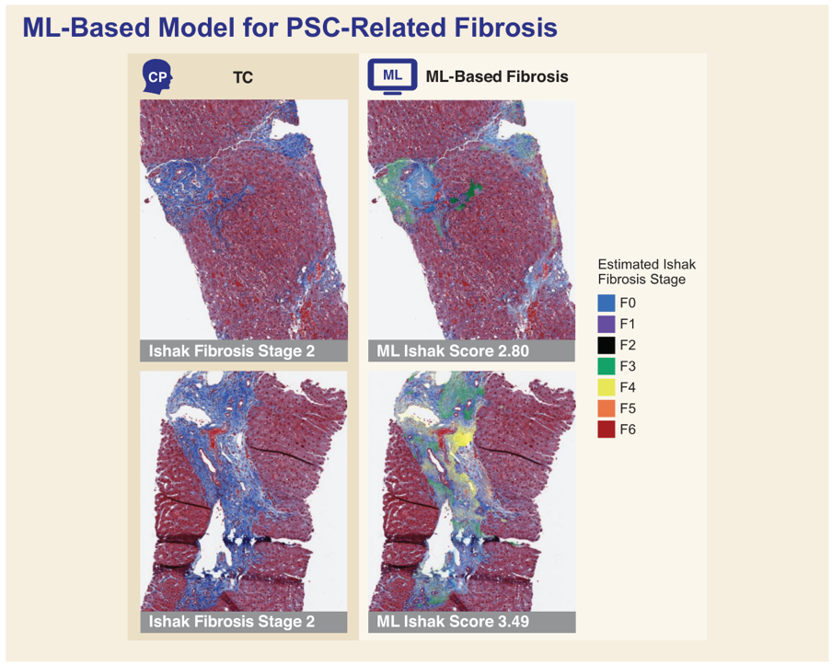

Slide 12
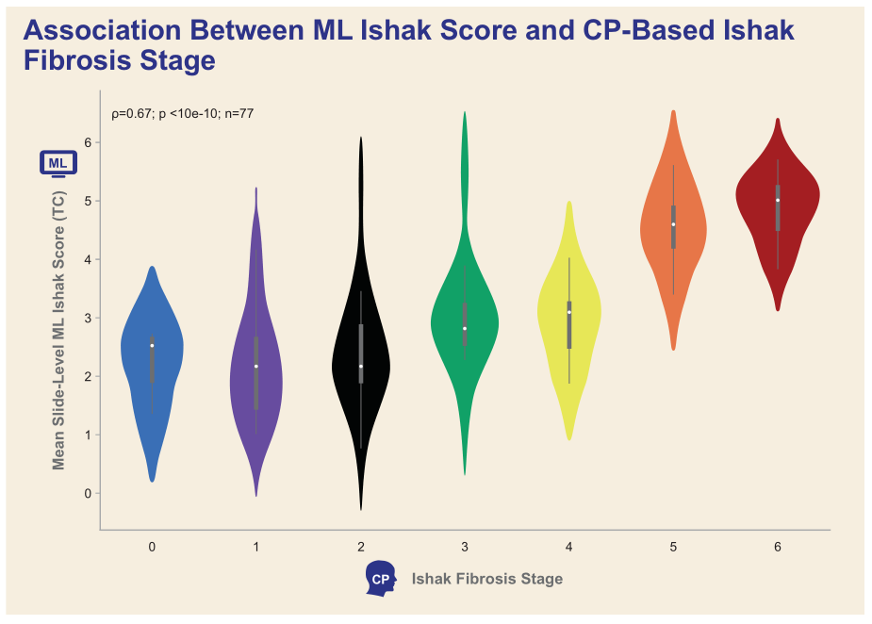
ML Ishak scores significantly correlated with Ishak stage scored by a CP

Slide 13
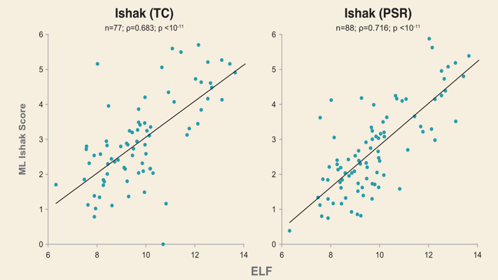
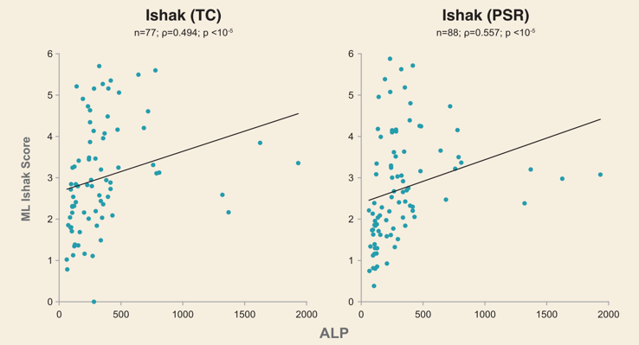
ML Ishak scores based on both TC- and PSR-stained biopsies were significantly associated with ELF and serum ALP

Slide 14
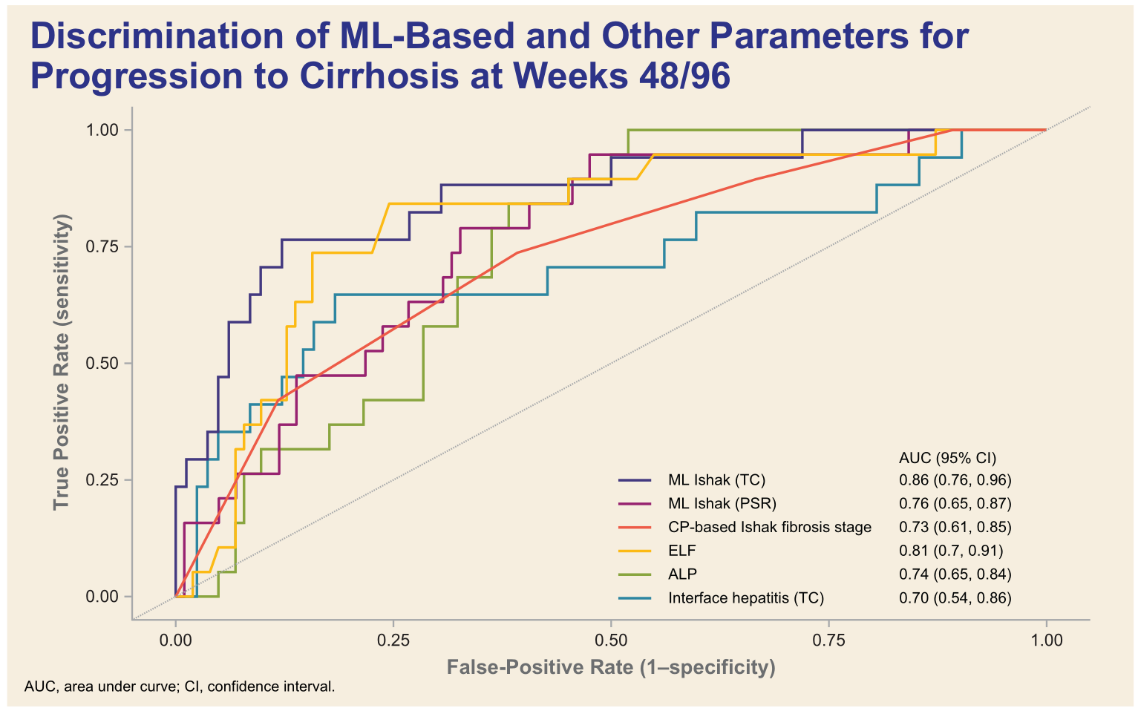
19/121 patients (16%) progressed to cirrhosis
Baseline ML fibrosis score was predictive of progression to cirrhosis at Weeks 48/96

Slide 15
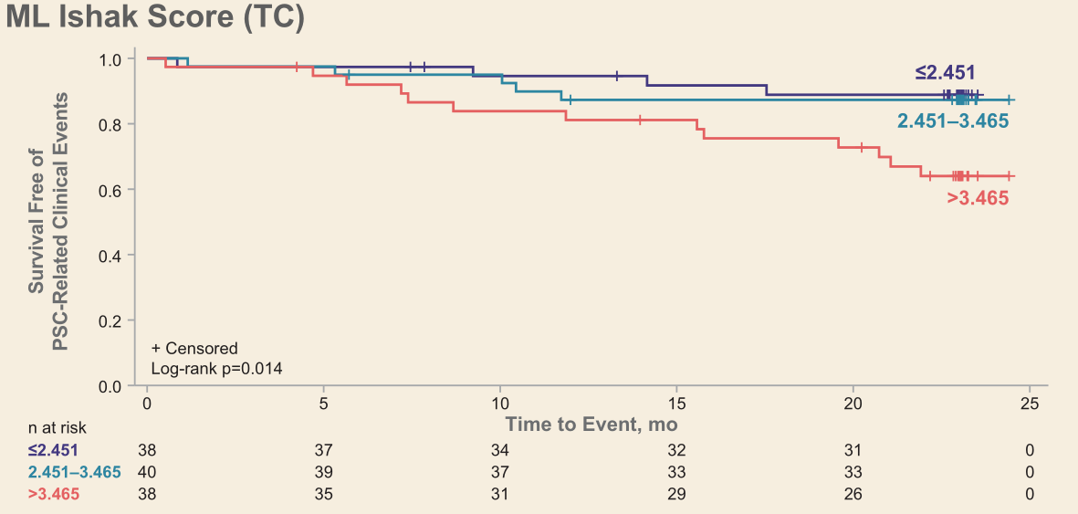

Slide 16
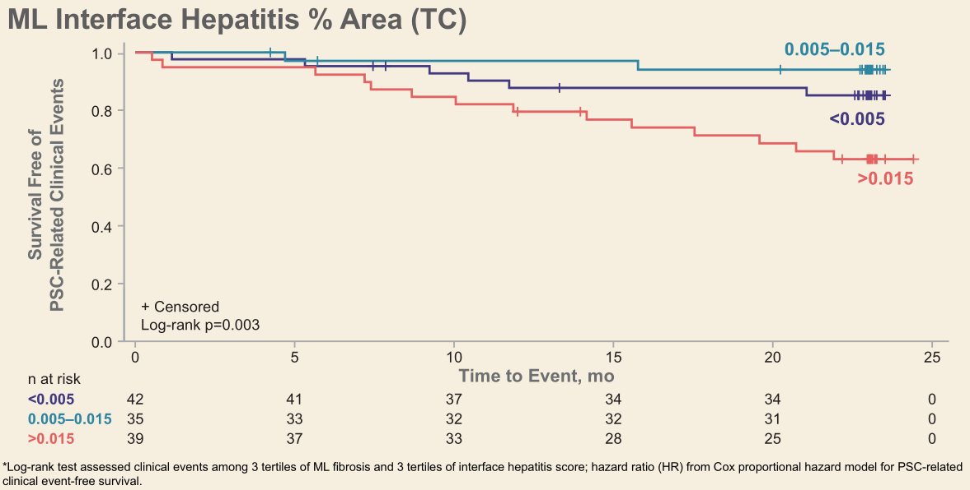

Slide 17
Methods
Over a median follow-up of 23 mo (IQR 18.9, 23.1), 21% of patients (29/141) developed a PSC-related event
Events were associated with higher ML Ishak fibrosis score at baseline (HR per unit: 1.74 [95% CI 1.18, 2.59]) and greater area of interface hepatitis (HR per 1%: 1.39 [95% CI 1.14, 1.70]), both on TC images

Slide 18
Conclusions
ML models demonstrated high concordance with pathologist assessment of PSC-related fibrosis
ML-derived measurements of fibrosis and interface hepatitis were associated with risk of PSC-related clinical events
These data highlight the potential of ML for automated and quantitative assessment of liver histology and risk stratification in PSC

