Slide 1
HCV SLTC

Slide 2
A novel hepatitis C intervention in Denmark to test and treat people who inject drugs
Jv. Lazarus¹, A. Øvrehus^{2,3}, J. DEMANT⁴, LOUISE KROHN-HEHLI⁵ And N. Wies^{5,6}
¹University of Barcelona, Barcelona Institute for Global Health (ISGlobal), Barcelona, Spain | ²Odense University Hospital, Department of Infectious Diseases, Odense, Denmark | ³University of Southern Denmark, Faculty of Health Sciences, Department of Clinical Research, Odense, Denmark | ⁴Brugernes Akademi, Copenhagen, Denmark | ⁵Copenhagen University Hospital, Department of Infectious Diseases, Hvidovre, Denmark | ⁶University of Copenhagen, Faculty of Health and Medical Sciences, Department of Clinical Medicine, Copenhagen, Denmark

Slide 3
Introduction
Providing testing and treatment for hepatitis C (HCV) for people who inject drugs (PWID) is a key component in eliminating HCV.
Reaching this population with health care services can be challenging.
Combining point-of-care testing with peer support and counselling has been shown to be effective.
However, treatment also needs to be more accessible.

Slide 4
Aim
To investigate if a mobile van equipped with rapid detection tests for HCV antibodies and RNA could test and link PWID to care and treatment in a hospital.

Slide 5
Method
In Copenhagen, Denmark, a peer-led mobile service providing counselling, anti-HCV testing (In-Tech™), and linkage to standard of care was equipped with a point-of-care HCV-RNA finger-prick test (Xpert HCV Viral Load Finger-Stick Point-of-Care Assay, Cepheid).
All clients were eligible for testing but only those with a legal residence in Denmark could be referred for treatment.
Eligible HCV-RNA+ individuals were offered assisted referral to a fast-track hospital clinic for treatment, and peers provided assistance as needed.

Slide 6
Results
From 1 May to 31 October 2019, a total of 304 anti-HCV tests were performed, and 42 individuals were found to be HCV-RNA+.
In addition, six individuals with known HCV infection contacted the service to be linked to care.
Of the 48 individuals with possible chronic HCV infection, 24 (50%) were evaluated at the hospital clinic and by 15 November 2019, all had initiated treatment with direct-acting antiviral therapy.
The main reasons for not being evaluated were being in the country illegally (n = 10, 42%) and being lost to follow up (n = 8, 33%).
Two died before being linked to care and two ended up in prison.
Among those initiating treatment, 14 were connected to drug treatment services and could be treated while receiving opioid substitution therapy.
The peer-led service assisted all treated with inter alia communication with the hospital nurse, collecting medicine, and accompaniment to follow-up visits.

Slide 7
Conclusions
A peer-led mobile service can engage PWID in HCV testing and treatment.
We identified being an illegal migrant as a major cause for not accessing care.
This poses a challenge for HCV elimination in Denmark, in part due to the risk of onward transmission, and is a health threat to the individual.

Slide 8
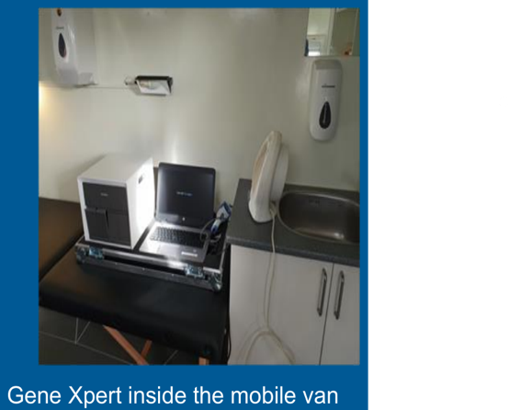

Slide 9
Declining HCV incidence following rapid HCV treatment scale-up in a prison network in Australia: Evidence of treatment a prevention from the SToP-C study
Behzad Hajarizadeh¹, Jason Grebely¹, Marianne Byrne¹, Pip Marks¹, Janaki Amin¹, Hamish McManus¹, Tony Butler¹, Peter Vickerman², Natasha K Martin2^{,3}, John G McHutchison⁴, Diana M Brainard⁴, Carla Treloar⁵, Andrew R Lloyd^{1,6}*, Gregory J Dore¹* on behalf of the SToP-C study group
¹The Kirby Institute, UNSW Sydney, Sydney, Australia; ²School of Social and Community Medicine, University of Bristol, UK; ³Division of Global Public Health, University of California San Diego, USA; ⁴Gilead Sciences, Inc., USA; ⁵Centre for Social Research in Health, UNSW Sydney, Sydney, Australia; 6Justice Health & Forensic Mental Health Network, New South Wales, Australia; *Andrew Lloyd and Gregory Dore contributed equally as the senior authors

Slide 10
Introduction
People who inject drugs (PWID) and people incarcerated are key populations contributing to HCV epidemics in many settings.
Effective HCV prevention and treatment interventions for these populations is central for HCV elimination efforts.
Although mathematical modelling demonstrated the potential for HCV treatment-as-prevention among PWID and in prison settings, there is limited empirical data to confirm modelling-based outputs in a real-world setting.
This study evaluated the impact of DAA treatment scale-up on HCV incidence within a network of prisons in New South Wales, Australia.

Slide 11
Methods
The Surveillance and Treatment of Prisoners with hepatitis C (SToP-C) is an interventional clinical trial within a cohort of participants enrolled through a network of four prisons in New South Wales, Australia.
Two prisons (Goulburn, and Lithgow) were maximum-security male prisons, and two prisons were medium-security prisons, one male (Outer Metropolitan Multi-Purpose
Correctional Centre; OMMPCC), and one female (Dillwynia) prison.
The SToP-C study participants were enrolled into an open prospective cohort: HCV status and risk behaviour were evaluated at study entry with ongoing evaluation of HCV incidence and risk behaviour on a six-monthly basis.
Study intervention involved treatment scale-up in which participants with detected HCV RNA were offered sofosbuvir/velpatasvir for 12 weeks.
The overall schedule of SToP-C, including the other components has been summarised in Fig 1.

Slide 12
Methods
Participants were screened for HCV at enrolment (anti-HCV Ab, and if positive HCV RNA).
Thus, from the screening visit, participants formed three sub- populations, including: 1) uninfected (anti-HCV-); 2) previously infected (anti-HCV+/RNA-); 3) infected (anti-HCV+/RNA+).
Uninfected and previously infected (i.e., HCV “at-risk”) participants were followed for HCV primary infection and re-infection, while infected participants were assessed for HCV treatment.
Treatment scale-up (intervention) started mid to late 2017. HCV incidence was compared between before DAA treatment scale-up period (2014-17) and after DAA treatment scale-up period (2018-19).
Incident HCV was defined as a positive anti-HCV Ab test among participants with a negative anti-HCV Ab at the previous visit (primary infection), and a positive HCV RNA test among participants with a negative HCV RNA at the previous visit (re-infection).

Slide 14
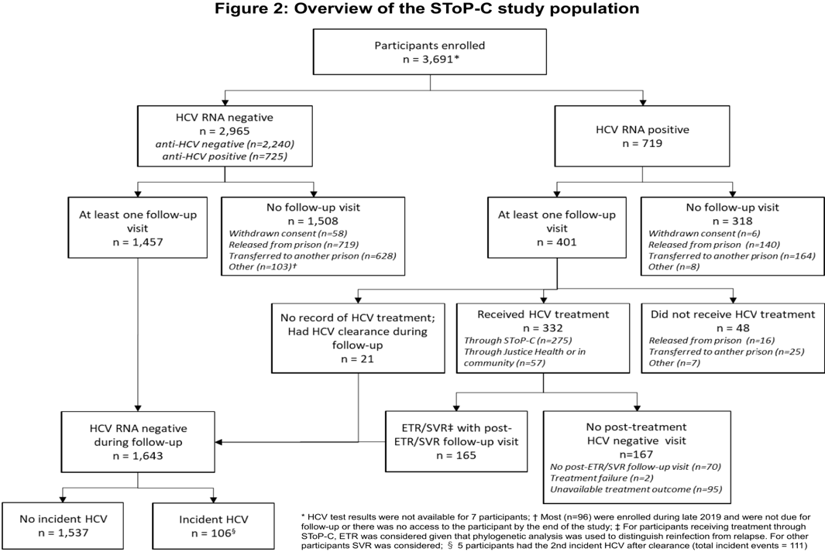

Slide 15
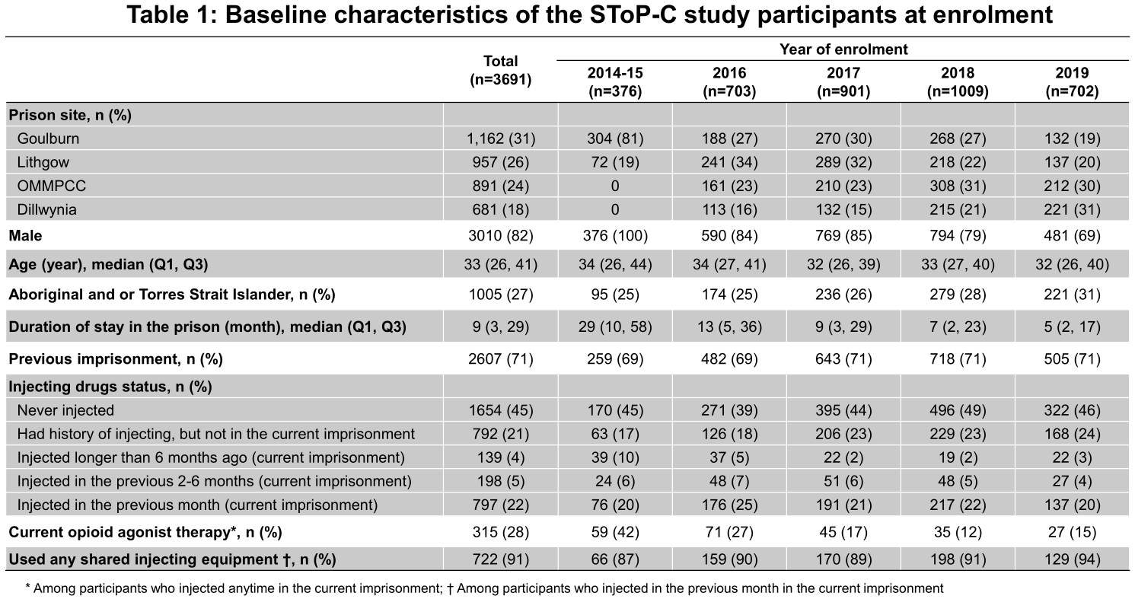

Slide 16
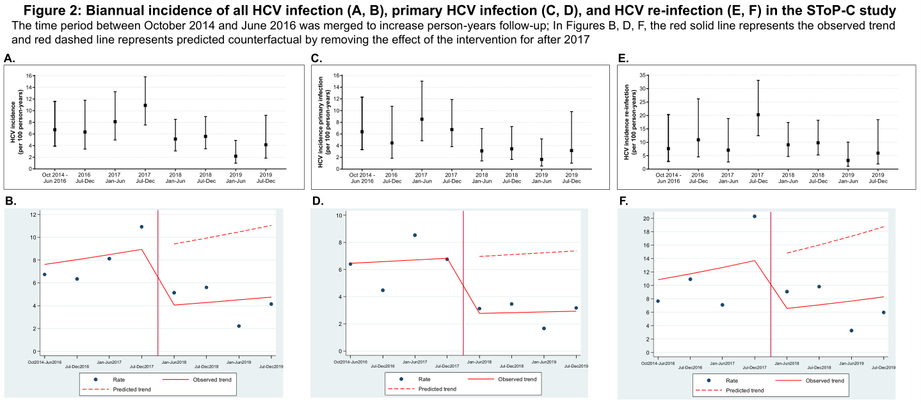

Slide 17
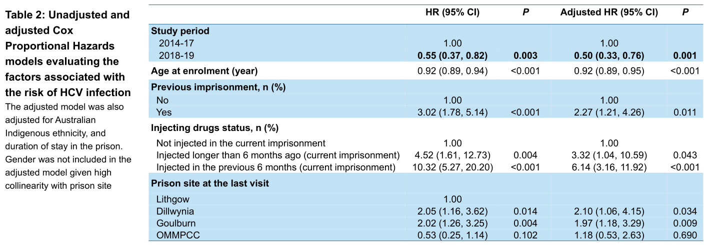

Slide 18
Conclusions
Rapid scale-up of DAA therapy was associated with HCV incidence reduction in prison, indicative of treatment as prevention.
The findings support broad DAA treatment scale-up among incarcerated populations, and enhanced harm reduction, particularly for prevention of re-infection.

Slide 19
Rapid hepatitis C treatment starts are a safe and effective means of pursuing viral elimination
Shawn Greenan, Deepti Kalani, Cory Ramsay, Merissa Mitchell, Lisa Barrett

Slide 20
Background
In 2015, PEI was the first Canadian province to develop and implement a comprehensive jurisdiction-wide HCV treatment program.
Multiple appointment visits have been demonstrated to be barriers to care in HCV elimination efforts.
Research in the HIV field has shown better HIV and non-HIV health care engagement with rapid, same day treatment starts.

Slide 21
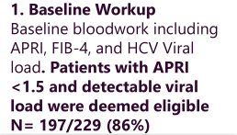
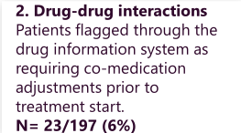
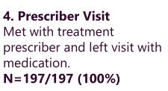
Methods

Slide 22
Extra results
Of the 224 (94.92%) patients who were eventually dispensed medication:
100 (44.64%) were successfully cleared,
90 (40.18%) are pending their SVR12,
26 (11.61%) are currently on treatment,
3 (1.34%) were found to have spontaneously cleared on day 0 viral loads
5 (2.23%) treatment failures occurred.
No serious adverse events or liver related decompensation occurred
Most common medications resulting in co-medication adjustments were: statins, ethyl-estradiol, and high-dose quetiapine

Slide 23
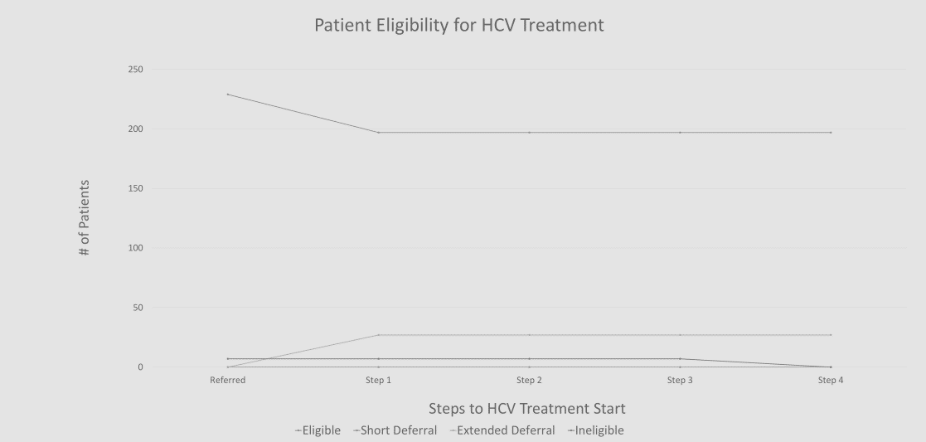

Slide 24
Is hospital admission an ideal condition for HCV screening? A survey from the Venetian area (North-east of ITALY)
A. Caroli¹, I. Franceschet¹, F. Fascì Spurio¹, L. Girardi¹, R. Cappuccio¹, D. Checchin¹, F. Lamboglia¹, A. Forti2, A. C. Scarparo³
¹UOC Gastroenterologia ed Epatologia, Ospedale dell’Angelo, Venezia-Mestre, Italy ²UOC Laboratorio Analisi, Ospedale dell’Angelo, Venezia-Mestre, Italy ³UOC Microbiologia, Ospedale dell’Angelo, Venezia-Mestre, Italy

Slide 25
Introduction
Which could be the most effective strategy to identify undiagnosed patients with HCV chronic hepatitis has not yet been identified.
Current guidelines recommend to screen all high-risk subjects.
However, strategies should be planned according to local HCV epidemiology.
In Veneto region (North-East of Italy), the real prevalence of HCV infection is currently unknown.
It is estimated to be between 0.5-1 % in the general population, which, per cost-benefit, would be probably too low to justify a community-wise screening.
On the other hand, hospitalized patients may represent the ideal population for HCV screening and for referral for treatment.

Slide 26
Aim
To determine the prevalence of HCV infection in unselected hospitalized patients in the Venetian area, North-East of Italy

Slide 27
Methods
All patients consecutively admitted to the surgical departments of the “dell’Angelo“ Hospital,Venezia-Mestre, from 01/01/2017 to 30/06/2018, were tested for anti-HCV antibodies (CMA Abbott laboratories).
In case of borderline values, a confirmatory RIBA test (INNOLIA HCV) was performed.
Positive patients were tested for HCV-RNA (RT-PCR Abbott laboratories).

Slide 28
Results
At admission, 11166 patients were tested for HCV infection.

Slide 29
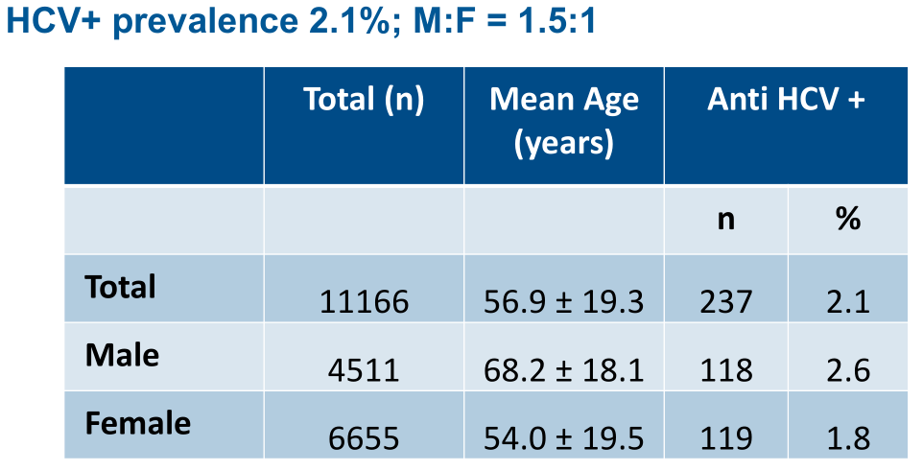

Slide 30
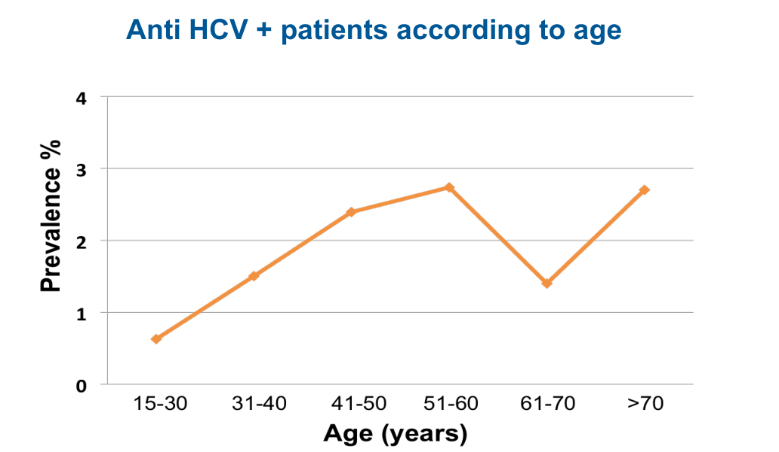

Slide 31
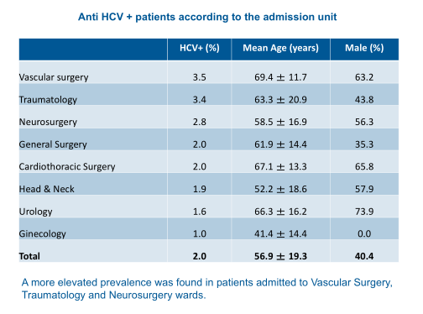

Slide 33
Conclusions
Our data show a significant prevalence of HCV infection in hospitalized subjects, two to three time higher than that expected in the general population of the Veneto region.
Screening for HCV Infection in this specific setting of subjects may thus represent an simple and cost-effective strategy to identify hidden HCV-infection and to refer for the treatment, in order to achieve HCV micro-elimination

Slide 34
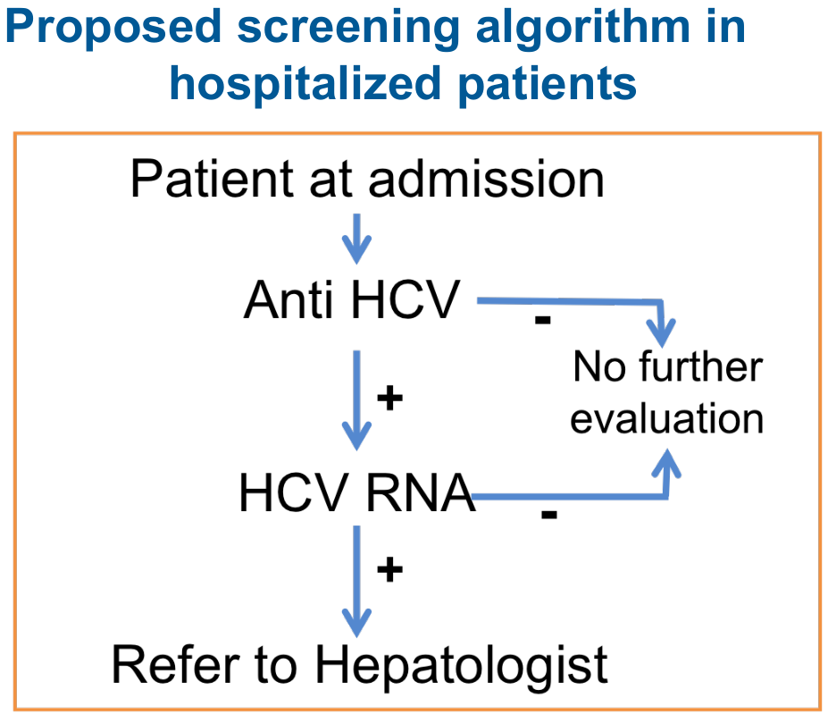

Slide 35
Searching for patients with chronic hepatitis C
lost in the system in a tertiary hospital:
A problem still to be solved
Irene Andaluz¹, María Del Mar Arcos², María Dolores Montero³, María Luisa Montes², Pilar Castillo¹, Luz Martin-carbonero², Javier García-samaniego^{1,4}, Miriam Romero¹, Araceli García¹, José Carlos Erdozaín¹, Carmen Busca², Juan González², Antonio Olveira¹.
¹ Department Of Gastroenterology; Hospital Universitario La Paz. Madrid. * (Ciberehd). ² HIV Unit, Department Of Internal Medicine, Hospital Universitario La Paz. Madrid, Idipaz. Madrid. ³ Department Of Microbiology, Hospital Universitario La Paz. Madrid ⁴ Instituto De Salud Carlos III, Ciberehd, Madrid, Spain

Slide 36
Introduction
Following the widespread use of direct-acting antivirals for the treatment of patients diagnosed with chronic hepatitis C, there is a growing interest in the elimination of this infection.
Various strategies to detect undiagnosed patients have been recommended.

Slide 37
Aim
To detect and in a second phase to contact with patients with chronic hepatitis C potentially lost in the system to offer them medical assistance.

Slide 38
Method
Patients with positive HCV-antibody between 2010-2018 from our Microbiology laboratory (tertiary Hospital covering 660,000 healthcare population) were analyzed.
Those with consecutive negative PCR-RNA HCV were excluded.
The Hospital and Regional databases were reviewed and sorted as: 1) chronic HCV: last determination of HCV RNA available positive, 2) cured HCV: last determination of HCV RNA available negative after ≥12 weeks of end of treatment, 3) possible HCV: positive HCV serology without determination of HCV RNA available.
Patients with chronic HCV or possible HCV without follow-up or scheduled with Gastroenterology/Internal Medicine were considered lost.
A descriptive analysis of all variables was performed.
The study was reviewed and approved by the center's Ethics Committee.

Slide 39
Results
4,592 patients with HCV positive serology were identified: 3,266 with detectable RNA and 1,326 without RNA determination.
677 patients (14.7%) lost in the system were detected (baseline characteristics are showed in Figure 1): 61% male, 12% foreigner, 95% mono-infected (non-HIV), median age 54 years (45-69).
The serological study of the lost patients was requested by Internal Medicine (11%), Gastroenterology (14%), Primary Care (33%) and other specialties (42%).
Of the 677 lost patients, 228 had positive PCR-RNA HCV and 449 only positive serology.
The classification of the remaining patients is shown in Figure 2.

Slide 40
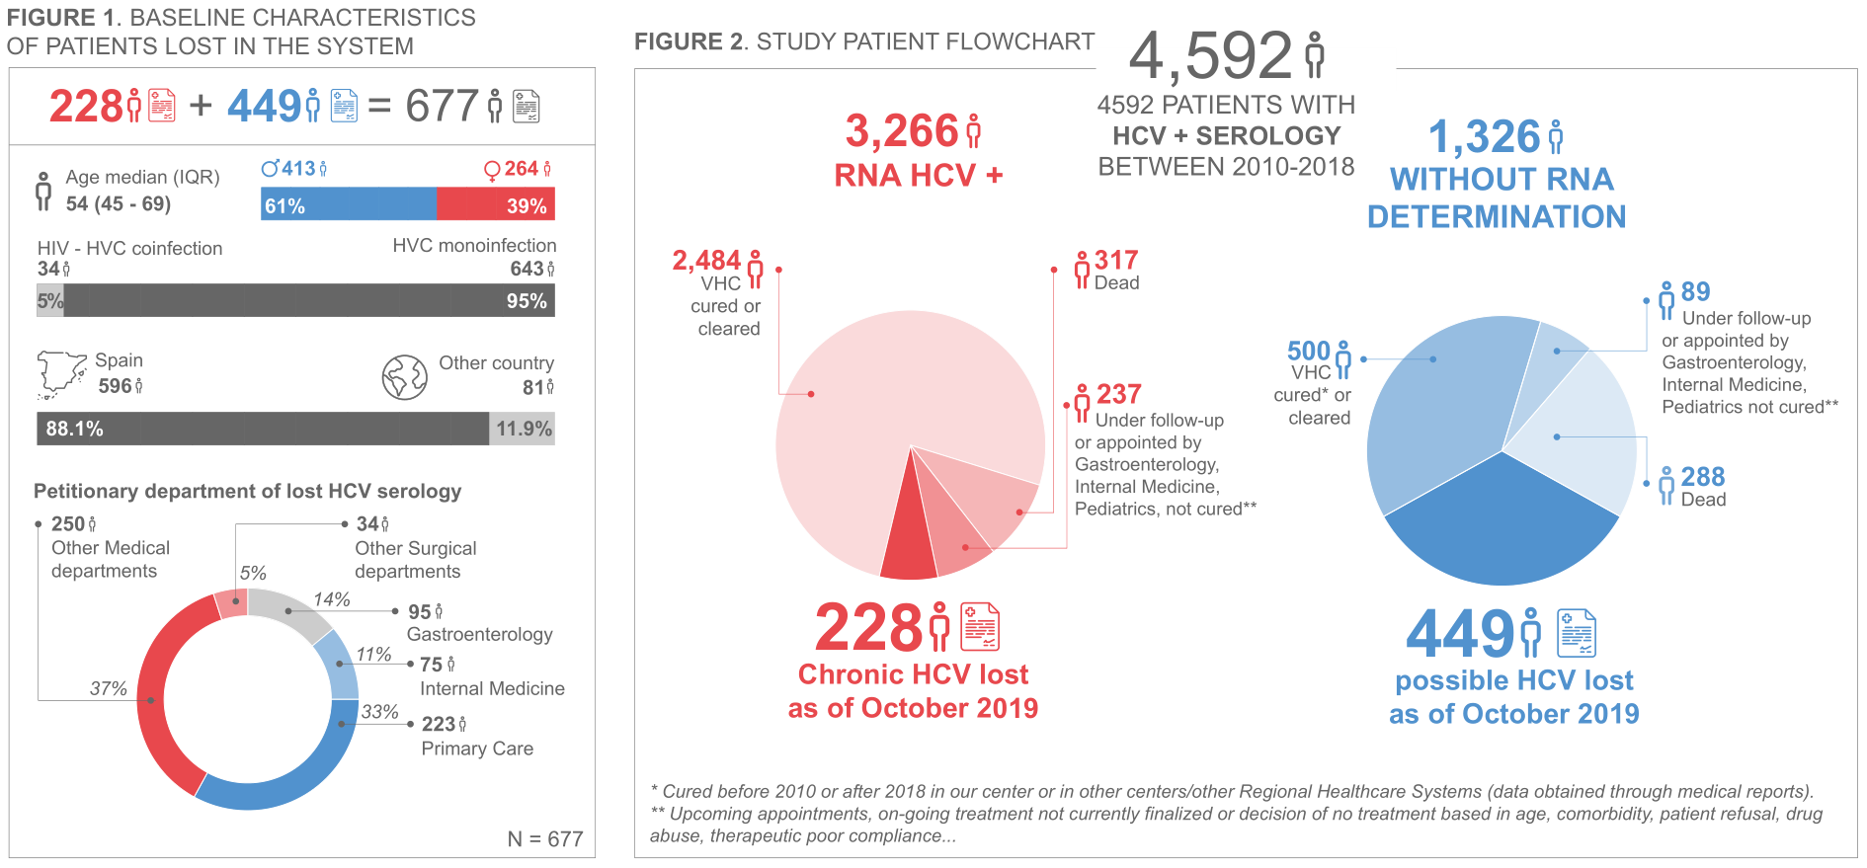

Slide 41
Conclusions
Despite the widespread possibility of HCV treatment in Spain since 2015, there is a significant number of hepatitis C patients lost in the system.
It is necessary to implement active detection strategies for these patients in order to achieve the goal of elimination.

Slide 42
Screening and linkage to care of prisoners with HCV infection: The RESIST-HCV project
L. Di Marco^{1,4}, T. Prestileo^{2,4}, F. Scalici³, R. Insinna³, M. Rossi¹, C. Celsa¹, M. Licata¹, S. Marchese², A. Di Lorenzo², M. Milesi², G. Rizzo¹, A. Busacca¹, F. Cartabellota⁴, V. Di Marco^{1,4} on behalf of RESIST-HCV (Rete Sicilia Selezione Terapia - HCV)
¹ Dipartimento Promozione della Salute, Materno Infantile, Medicina Interna e Specialistica di Eccellenza (PROMISE), Università di Palermo ² U.O.C. Malattie Infettive, ARNAS-Civico, Palermo ³ Area Medica della Casa Circondariale “Pagliarelli-Lorusso”, Palermo ⁴ Rete Sicilia Selezione Terapia HCV (RESIST-HCV), Sicily

Slide 43
Background
In prisons there is high prevalence of hepatitis C virus (HCV) infection, high rate of PWID and a substantial risk of HCV transmission.

Slide 44
Aims
Epidemiological studies are needed to evaluate the rate of prisoners with chronic HCV hepatitis and to establish how many of them need Direct Acting Antiviral (DAA) therapy.

Slide 45
Methods
We conducted a cross-sectional study to explore the prevalence of HCV infection in all prisoners of Pagliarelli-Lorusso prison in Palermo (Sicily).
At July 2019 prisoners received information on the virological test, the diagnosis of chronic hepatitis and the possibility of obtaining antiviral therapy inside the prison.
Anti-HCV antibodies was detected by OraQuick HCV rapid oral test.
Prisoners with positive screening performed serum HCV-RNA and viral genotype, evaluated liver disease stage by Fibroscan and received antiviral therapy.
All prisoners signed an informed consent to use demographic, clinical and virological data.
Chi-square test was used to analyze differences between groups

Slide 46
Results
Among 1,142 prisoners (87.0% of entire population of the prison) who participated in the study, 1,111 (97.3%) accepted to perform oral test for HCV antibodies.
Prisoners had a mean age of 42 ± 13 years without differences in 1,035 males (93.2%) and 76 females (6.8%).
Overall, 53 prisoners (4.8%) resulted HCV antibody-positive: 45 out of 1,035 males (4.3%) and 8 out of 76 females (10.5%) (p=0.02).
Twenty-five out of 99 people (25%) who inject drug (PWID) and followed a program of opioid substitution therapy (OST) and 28 out of 1,012 no-PWID prisoners (2.8%) were anti-HCV positive (p<0.0001).
The prevalence of HCV antibodies was 22% (19/87) among males PWID and 50% (6/12) among females PWID (p=0.06).
Prisoners were more frequently infected with genotypes 1a (36%) or 3 (44%).
Thirteen out of 25 anti-HCV positive PWID (52%) and 13 out of 28 anti-HCV positive prisoners (46.4%) without history of drugs addict had a previous diagnosis of HCV infection (p=0.7).
Teen out of 28 prisoners (35.7%) with a previous diagnosis of HCV infection (5 of 25 PWID and 5 of 28 no-PWID) had already received a cycle of antiviral therapy.

Slide 47
Conclusions
Overall prevalence of HCV infection among prisoners is at least 4 times greater than in the general population and the main risk factor is a history of injecting drug use.
About half of the prisoners with positive screening did not know their HCV infection.
Only 35% of people with a known HCV infection had received antiviral therapy before arriving in prison.
In prisons, it should be mandatory to program on-side screening for HCV infection and linkage to care patients with chronic liver disease.

Slide 48
