Slide 1
NASH

Slide 2
Obeticholic Acid demonstrates sustained improvements at month 24 in transaminases and non-invasive markers of fibrosis: Results of a Post hoc analysis from the interim analysis of the REGENERATE study
Rohit Loomba,¹ Vlad Ratziu,² Quentin M. Anstee,³ Stephen Harrison,⁴ Arun J. Sanyal,⁵ Mary Rinella,⁶ Zobair M. Younossi,⁷ Zachary Goodman,⁷ Pierre Bedossa,⁸ Reshma Shringarpure,⁹ Huafeng Zhou,⁹ Aditya Venugopal,⁹ Mazen Noureddin10
¹University of California, San Diego, San Diego, CA, USA; ²Sorbonne Université, Hôpital Pitié–Salpêtrière, Paris, France; ³Translational & Clinical Research Institute, Faculty of Medical Sciences, Newcastle University, Newcastle upon Tyne, United Kingdom; ⁴Pinnacle Clinical Research Center, San Antonio, TX, USA; ⁵Virginia Commonwealth University, Richmond, VA, USA; ⁶Feinberg School of Medicine, Northwestern University, Chicago, IL, USA; ⁷Betty and Guy Beatty Center for Integrated Research, Inova Health System, Falls Church, VA, USA; ⁸Service d’Anatomie Pathologique, Hôpital Beaujon, Assistance Publique-Hôpitaux de Paris, Paris, France; ⁹Intercept Pharmaceuticals, San Diego, CA, USA; ¹⁰Cedars-Sinai Medical Center, Los Angeles, CA, USA

Slide 3
Introduction
The planned interim analysis of the REGENERATE study (NCT02548351) demonstrated that treatment with obeticholic acid (OCA) improved histologic liver fibrosis in patients with nonalcoholic steatohepatitis (NASH) after 18 months of therapy
OCA 25 mg achieved the primary endpoint of fibrosis improvement ≥1 stage with no worsening of NASH after 18 months of therapy (OCA 25 mg: 23%; placebo 12%; p=0.0002). OCA 25 mg was able to reverse fibrosis by ≥1 stage in 37% of patients (vs 23% on placebo)
Noninvasive tests (NITs) are predictive of histologic changes and liver-related outcomes in NASH
Vibration-controlled transient elastography (VCTE) is an imaging technique that measures liver stiffness as a surrogate of fibrosis
Probability of liver-related mortality is correlated with VCTE score
A secondary analysis of REGENERATE demonstrated that, consistent with observed histologic improvements in fibrosis, OCA treatment improved NITs in a time- and dose-dependent manner
Rapid improvements were observed in both serum-based NITs and imaging NITs as early as 3 months and sustained through 18 months

Slide 4
Aim
To assess durability of response and the relationship between changes in noninvasive markers beyond 18 months and histologic fibrosis improvement
Changes in liver biochemistry and noninvasive markers of fibrosis were analysed in patients with available 24-month data at the time of the prespecified 18-month interim analysis

Slide 5
Methods
STUDY DESIGN AND PATIENTS
Patients with biopsy-confirmed NASH, nonalcoholic fatty liver disease (NAFLD) activity score (NAS) ≥4, and fibrosis stage 2 or 3 were randomised (1:1:1) to receive placebo, OCA 10 mg, or OCA 25 mg once daily (QD) (Figure 1)
The intent-to-treat (ITT) population included patients with fibrosis stage F2–F3 who had received ≥1 dose of treatment and reached, or would have reached, the Month 18 visit by the prespecified interim analysis cut-off date
Patients from the interim analysis ITT population randomised early enough to have both evaluable Month 18 biopsies (N = 251–263 per treatment arm) and Month 24 data at the time of the interim analysis (N = 120–125 per arm) were included in this analysis

Slide 6
Methods
NONINVASIVE ASSESSMENTS
Transaminases (alanine aminotransferase [ALT] and aspartate aminotransferase [AST])
Gamma-glutamyl transferase (GGT)
Serum markers of fibrosis (fibrosis-4 [FIB-4], and AST to platelet ratio index [APRI])
Liver stiffness (FibroScan® VCTE)
Subset (N = 87–89 per arm at Month 24)
Collected at sites with the capability of performing VCTE
Collection of VCTE data was not required after Month 18

Slide 7
Methods
ANALYSES
Changes from baseline to Month 24 in ALT, AST, GGT, FIB-4, APRI, and liver stiffness by VCTE were analysed
Changes in noninvasive markers were also assessed by patients’ histologic fibrosis status at the time of the Month 18 interim analysis
Month 18 fibrosis status was classified into 3 categories: (1) improvement of fibrosis by ≥1 stage, (2) no change in fibrosis stage, and (3) worsening of fibrosis by ≥1 stage
Analyses were conducted in the ITT population with non-missing values in both fibrosis stage and NIT values
Based on significant improvements with OCA 25 mg, here we report only 25 mg results

Slide 9
Results
Baseline characteristics were generally balanced across treatment groups (Table 1) in the ITT population

Slide 10
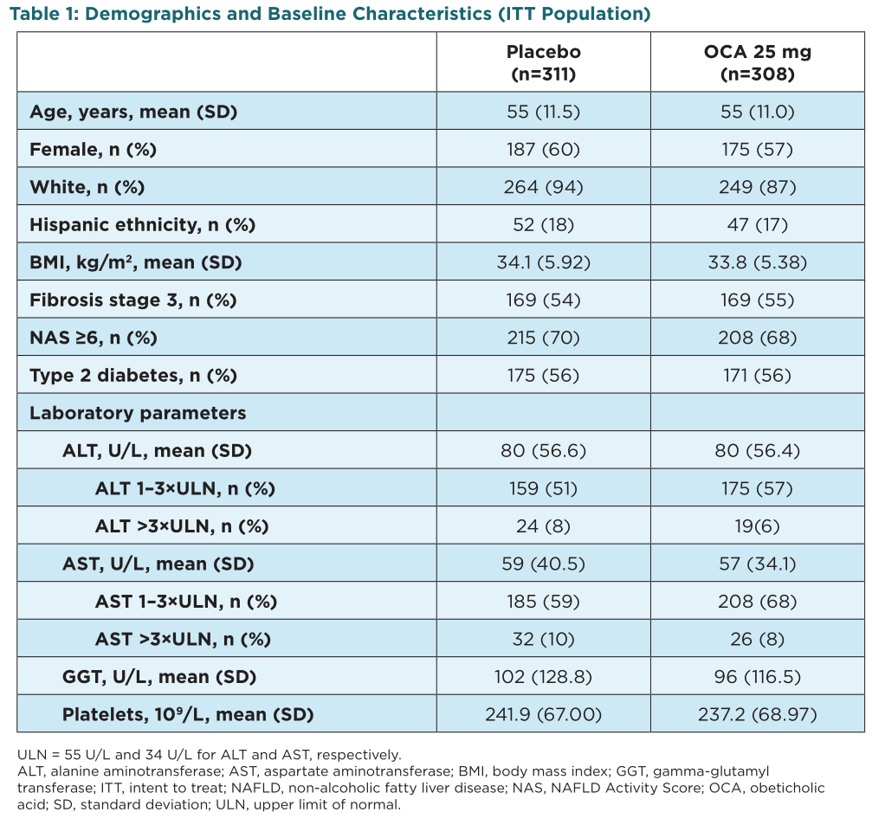

Slide 11
Results
Mean values of transaminases and other serum tests improved rapidly in patients treated with OCA. Improvements were sustained after 24 months of therapy with OCA 25 mg compared with placebo in patients who had Month 24 data (Figures 2–6)
Liver stiffness, measured by FibroScan® VCTE, also continued to improve over time, with a mean difference of 2.7 kPa between OCA 25 mg and placebo after 24 months on therapy (Figure 7)

Slide 14
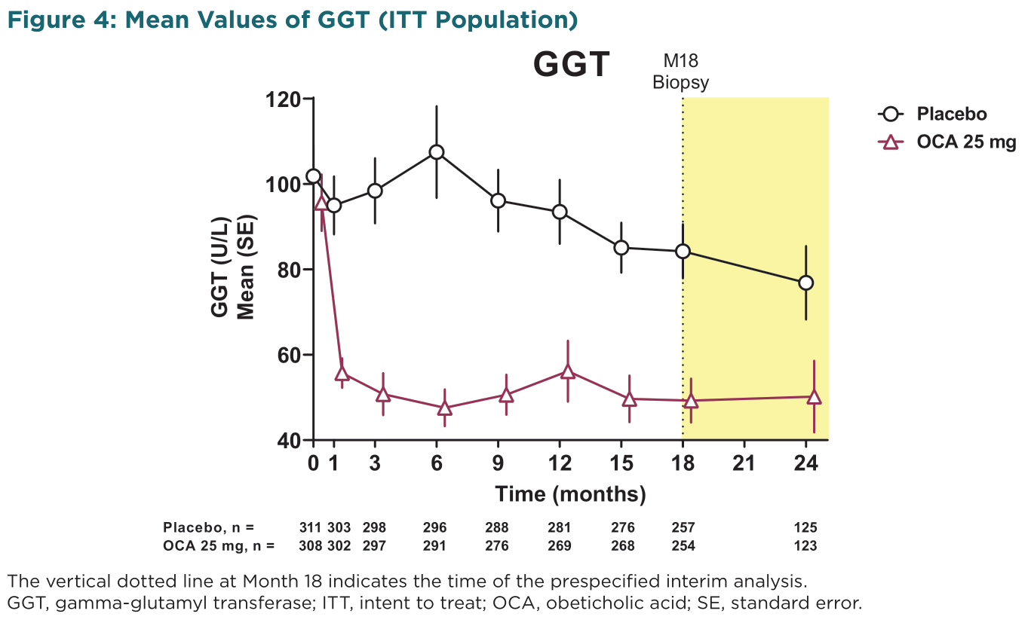

Slide 15
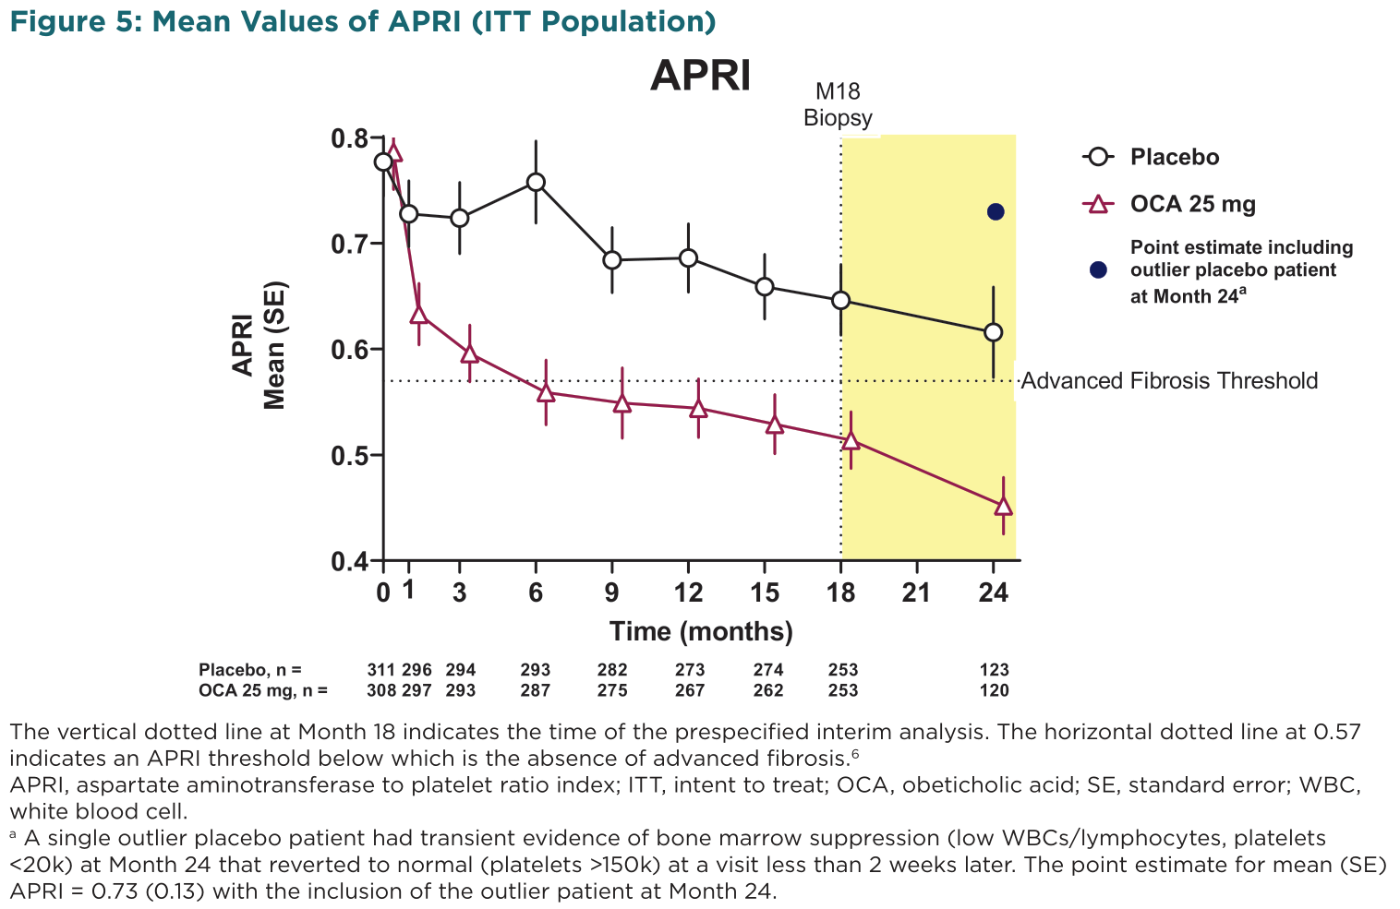

Slide 16
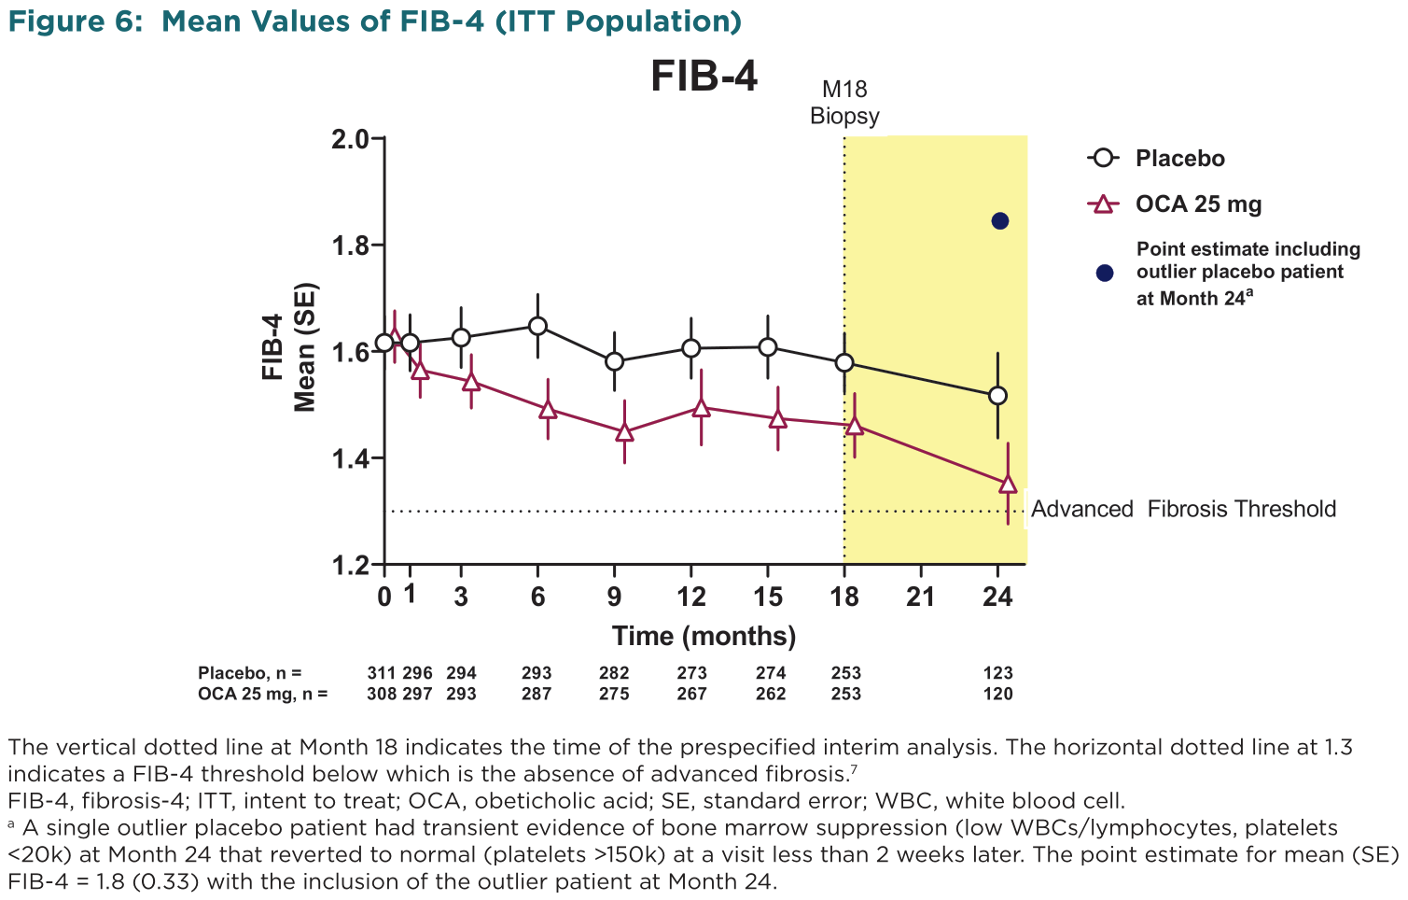

Slide 17
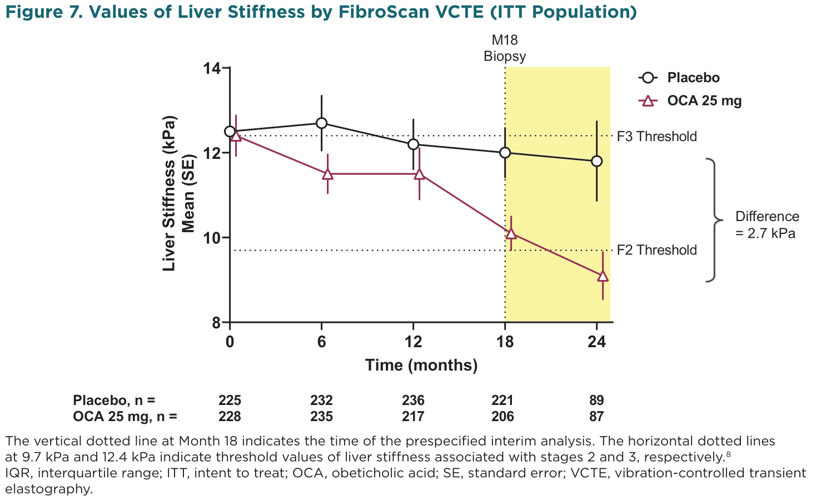

Slide 18
Results
Changes in AST, ALT, and VCTE were associated with changes in histologic fibrosis, with the greatest improvements observed in patients who had a ≥1 stage improvement in fibrosis stage at Month 18 (Figures 8–10)
Moreover, early changes in these markers were more pronounced in patients who had histologic fibrosis improvement at Month 18
Similar patterns were observed with GGT and the composite NITs that include transaminases (APRI and FIB-4; data not shown)

Slide 19
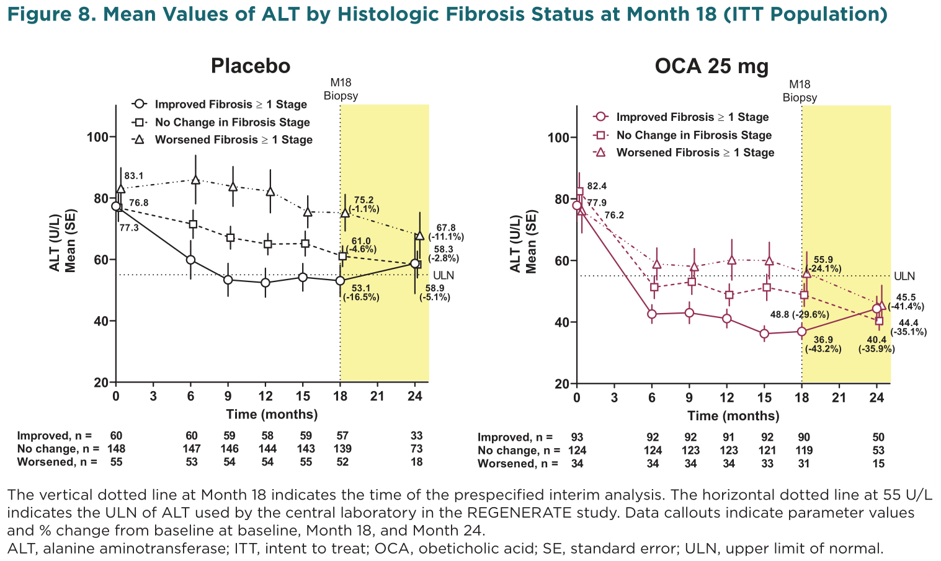

Slide 20
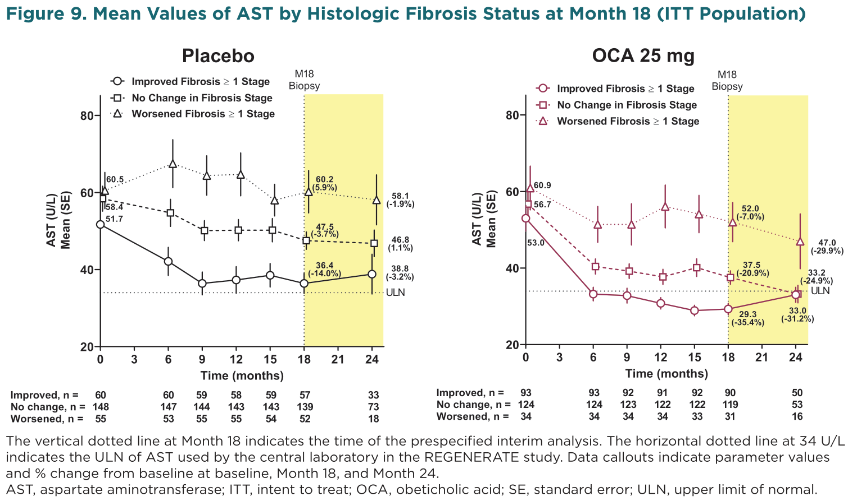

Slide 22
Results
The overall adverse event (AE) profile of OCA 25 mg in the subgroup of the ITT population with 24 months of follow-up was consistent with that observed in the overall ITT population (Table 2)
The incidence of serious adverse events (SAEs) was balanced across the placebo and OCA 25 mg groups
Few SAEs occurred in >1 patient and no consistent pattern of SAEs was observed

Slide 23
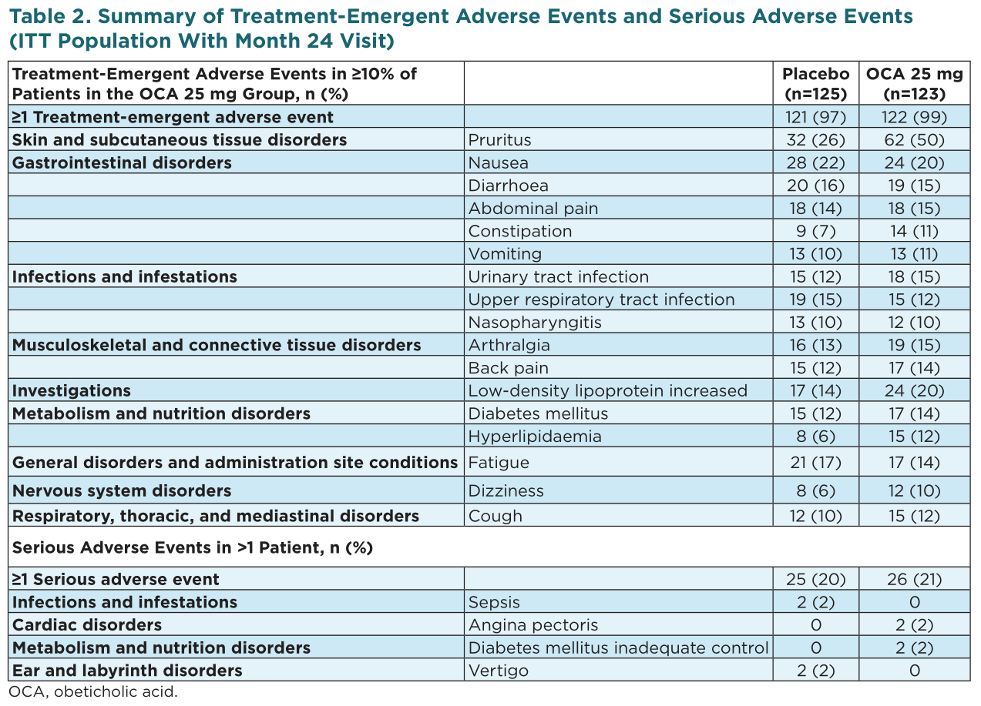

Slide 24
Conclusions and Limitations
In patients with available data after 24 months of therapy, OCA 25 mg elicited durable improvements in transaminases, non-invasive serum markers of fibrosis, and liver stiffness by VCTE at Month 24, suggesting continued improvement beyond the categorical histologic benefit
Improvement in these markers was associated with improvement in histologic fibrosis
Early changes in biochemical markers such as ALT may reflect reduced inflammation, whereas changes in liver stiffness are a more direct measure of fibrosis and may not be observed early in treatment
The AE profile in the subgroup of patients with Month 24 data was consistent with that observed in the overall ITT population, and no new safety signals emerged
The REGENERATE study remains ongoing and will continue for verification and description of clinical benefit

Slide 25
Association of FIB4 score with disease progression in real-world populations diagnosed with NAFLD/NASH or at risk of NASH in US Clinical Practice
Michelle Lai¹, Jeremy Broestl², Andrew Frick², Richard Haubrich³, Bruce Koch³, Scott Milligan², Macky Natha³, Zobair Younossi^{4,5}, and Nezam Afdhal¹
¹Beth Israel Deaconess Medical Center, ²Trio Health Analytics, ³Gilead Sciences, Inc ⁴Center for Liver Diseases, Department of Medicine, Inova Fairfax Hospital, Falls Church, VA, ⁵Betty and Guy Beatty Center for Integrated Research, Inova Health System, Falls Church, VA

Slide 26
Background and aim
Patients with NASH or NAFLD are at increased risk of developing advanced liver disease. Using data from clinical practices in the US, we assessed the risk of NASH, cirrhosis, decompensated cirrhosis (DCC), hepatocellular carcinoma (HCC), and liver transplant (LTX) in populations with diagnosed NAFLD or NASH, or who were deemed at risk of NASH based upon clinical criteria.

Slide 27
Methods
Data obtained from a proprietary EMR database were limited to adult patients with diagnosed NAFLD or NASH, or with a risk profile (RISK) of Age >50 + ALT >30 U/L + [BMI >30 or Type II diabetes] and without viral hepatitis or alcohol abuse.
Index date was the first calculable FIB4 between Jul 2015 to Jun 2017 with >1y history and >2y follow-up or to death.
Univariate analyses were via Wilcoxon (continuous) and Fisher’s Exact (categorical) tests.
Incidence rates were calculated by cases/1000 person-years, with Poisson exact confidence interval method, stratified by both NASH/NAFLD/RISK group and FIB4 group.
Cumulative incidence curves with associated log-rank test were computed, stratified by FIB4 group.
Cox proportional models were used to determine hazard ratios (HR) between groups, stratified by age and BMI group status at index.
All multiple regression models used complete-case analysis and included diagnosis group, FIB4, race/ethnicity, and all covariates with p <0.200 by individual models.

Slide 28
Patient Characteristics at index date
Of 30 million adult patients, 81,108 met all study criteria with 22% (17,582) NAFLD (without NASH), 1% (914) NASH, and 77% (62,612) RISK (without NAFLD or NASH diagnosis) at index.
Significant differences were observed between 2+ diagnosis groups for age, gender, race, BMI, comorbidities, and laboratory measures HDL and LDL cholesterol, triglycerides, blood glucose, platelets, and FIB4 at index.
The proportion of patients with FIB4 ≥2.67 was significantly higher for NASH compared to NAFLD which was significantly higher than RISK [Table 1].

Slide 29
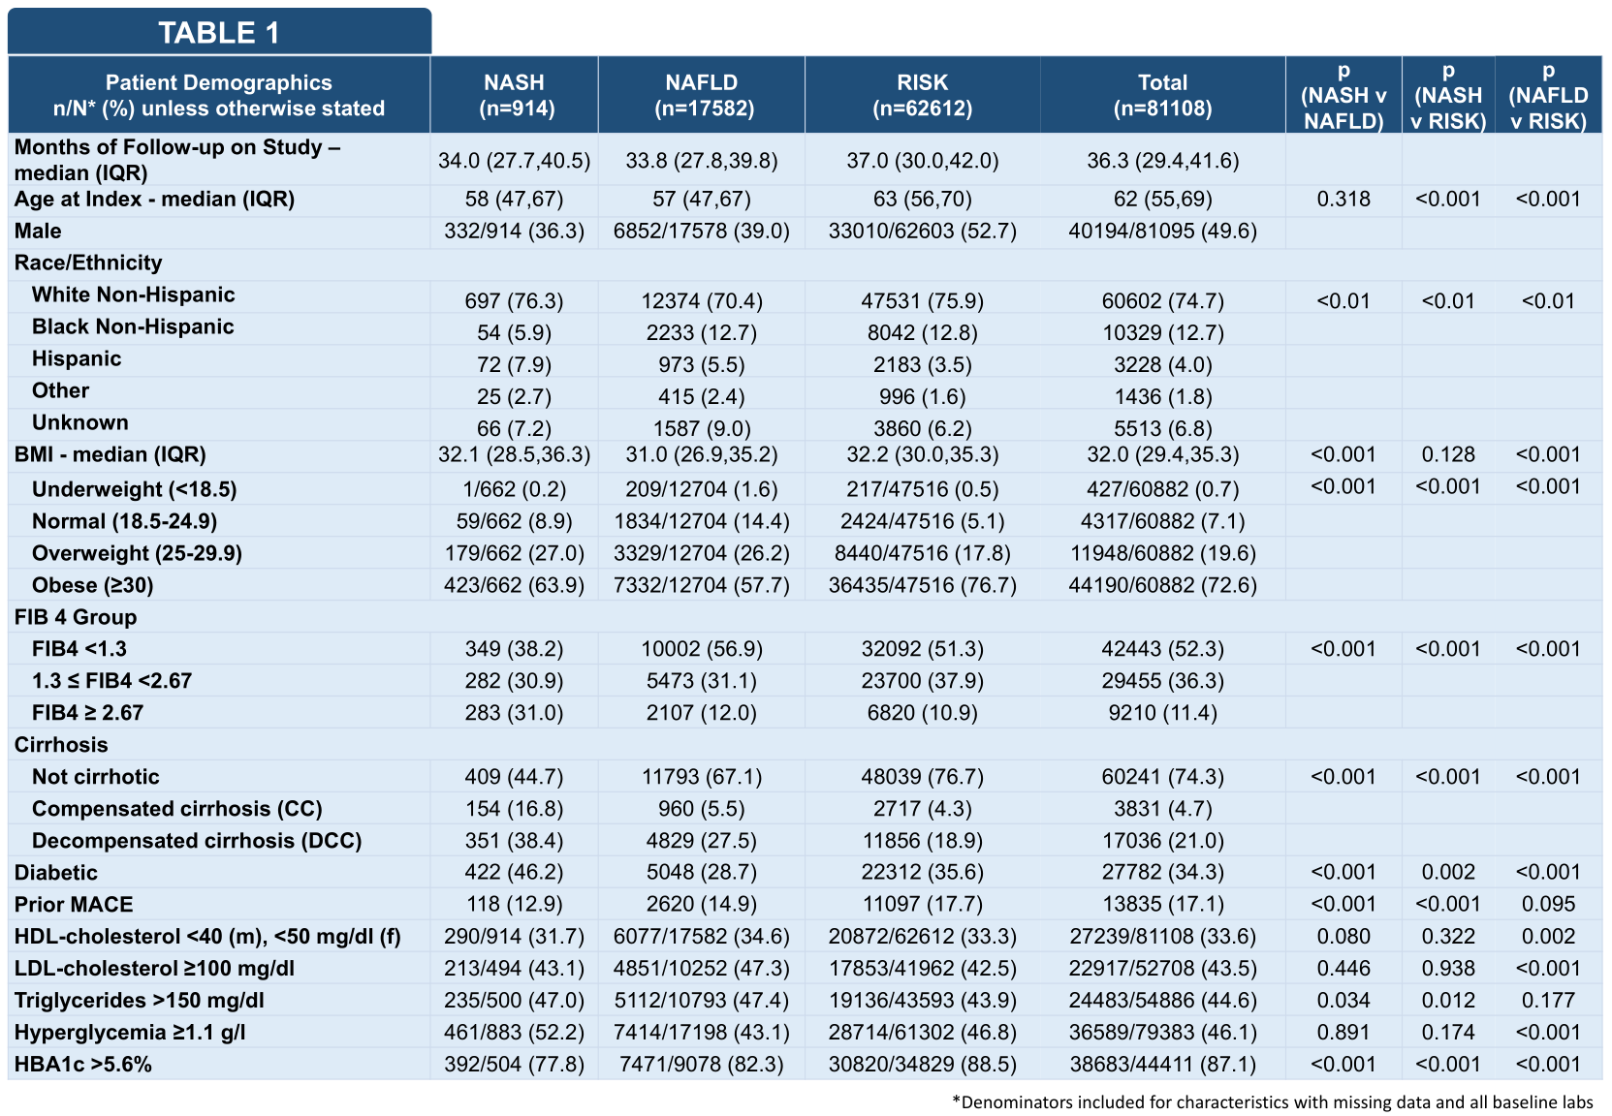

Slide 30
Incidence Rates By Risk Group And Fib4 Group
Incidence rates for all outcomes increased significantly by increasing FIB4 score for overall incidence and incidence within each NASH/NAFLD/RISK cohort [Table 2].

Slide 31
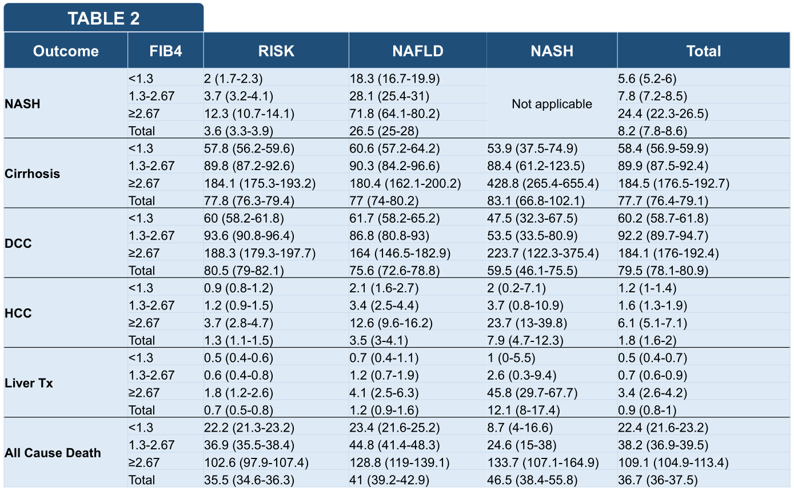

Slide 32
Cumulative Incidence Curves
High FIB4 scores (≥2.67) were associated with increased hazard of development of advanced liver disease and all-cause death in study cohort [Figure 1].

Slide 33
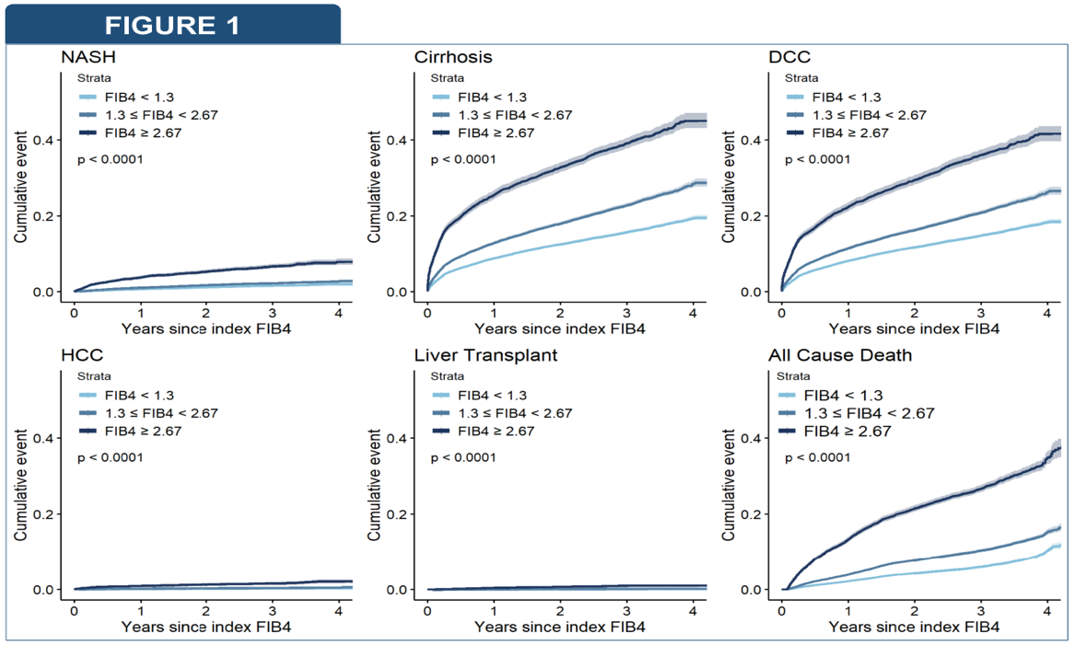

Slide 34
Cox Regression Results
Results from Cox regression models indicated FIB4 ≥2.67 had the highest or 2nd highest HR for all evaluated outcomes.
[FIGURE 2] Other variables associated with high HR were: index NAFLD for NASH outcome, prior major cardiovascular events (MACE) for cirrhosis and DCC outcomes, index NASH for LTX outcome, index NASH and index NAFLD for HCC outcome, and MACE for all-cause death.
HR for cirrhosis and DCC outcomes were not significantly different between NASH, NAFLD, and RISK covariates.
Cox models included strata for Age group (18-50, 51-64, 65-74, 75+) and BMI group (<18.5, 18.5-24.9, 25-29.9, 30+). Potential interactions between NASH/NAFLD/RISK group and FIB 4 groups were investigated and found to be non-significant and excluded from final multiple regression models.

Slide 35
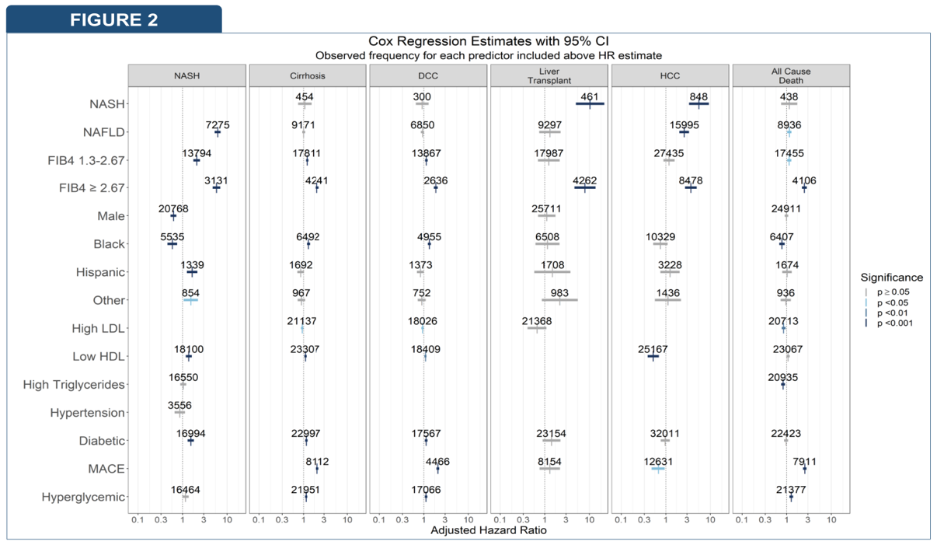

Slide 36
Summary
Using data from a national EMR database, we examined the development of advanced liver disease in 81,108 patients with NASH, NAFLD (without NASH), or at risk of NASH.
Analyses including Cox proportional models identified FIB4 ≥ 2.67 as associated with increased incidence rate for all outcomes and all-cause mortality.
NASH diagnosis was associated higher rate of Liver Transplants and HCC during follow-up; however number of cases was limited in these analyses.
Index NAFLD was strongly associated with NASH diagnosis during follow-up. Risk of developing cirrhosis during follow-up was found to be associated with NASH or NAFLD status at index date

