Slide 1
HCV

Slide 2
Micro-elimination of hepatitis C in mental health care settings
K. McKee¹, A. Chu¹, M. Robotin², G. McCaughan³, J. Pritchard-Jones³, B. Kotze⁴, C. Fozzard⁵, A. Yesudoss⁵ and J. George¹
¹ Storr Liver Centre, Westmead hospital and University of Sydney, Sydney, Australia ² The University of Notre Dame, Sydney, Australia ³ A. W. Morrow gastroenterology and Liver Unit, Royal Prince Alfred Hospital and University of Sydney ⁴ Mental Health Services, Western Sydney Local Health District ⁵ Community Mental Health Services, Western Sydney Local Health District

Slide 3
Introduction
Marginalised populations including people with mental illness are disproportionally affected by chronic hepatitis C (CHC).

Slide 4
Aim
We sought to achieve inpatient and community mental health CHC micro-elimination in Western Sydney, Australia.

Slide 5
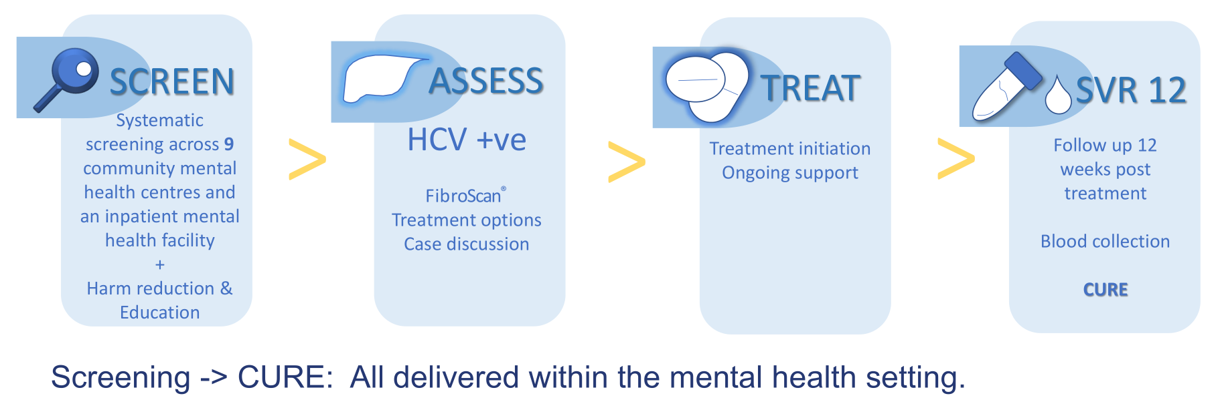
Method

Slide 6
Results
To date, 716 patients have been screened, 41% (n=293) were inpatients while 59% (n=422) were within the community mental health setting (Figure 1).
During the latter half of the project, the availability of a pathology collector at community clinics reduced the time between initial contact and blood collection and increased likelihood of consent to testing, in many instances initial contact resulted in screening on theday same.

Slide 7
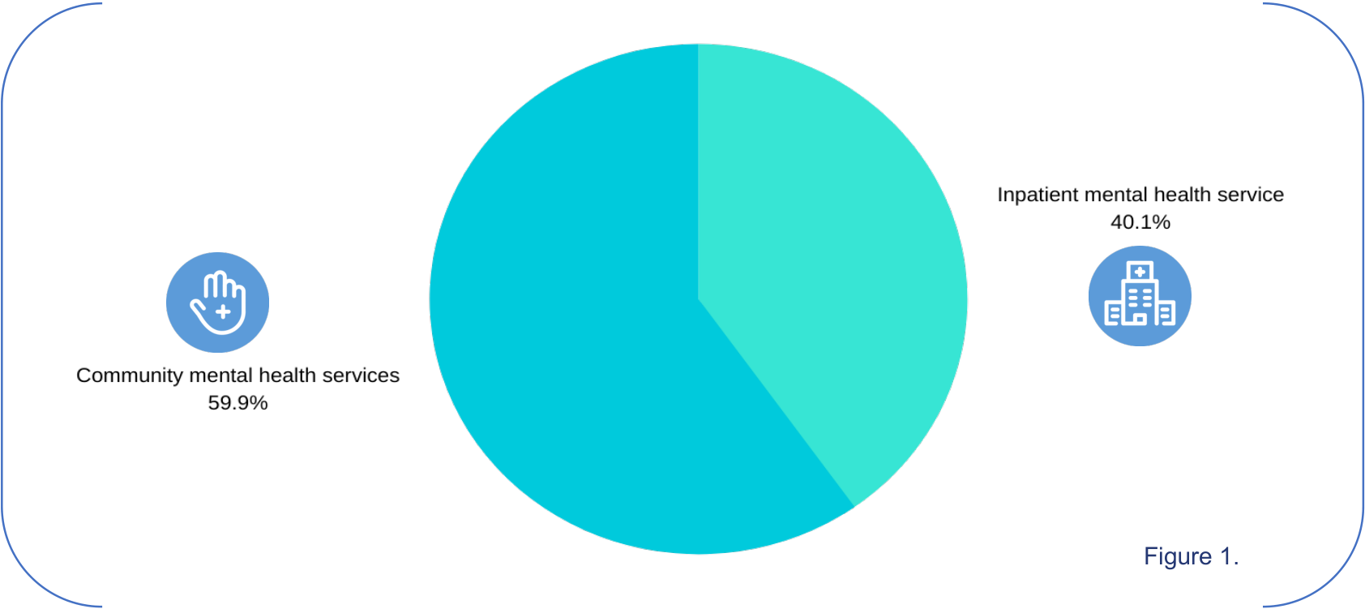

Slide 8
Results
Eleven inpatients commenced treatment
4 achieved a sustained virological response (SVR)
6 are awaiting week 12 results
1 treatment failure
Five others are awaiting treatment
3 were discharged and require further follow up
4 refused treatment (Figure 2)

Slide 10
Results
17 patients assessed for treatment within the community setting
3 commenced treatment
2 completed and await SVR
1 continues on treatment
3 are on the treatment pathway
6 refused treatment
1 spontaneously cleared
3 discharged to another service
1 patient diagnosed with hepatocellular carcinoma (Figure 3).

Slide 12
Conclusions
CHC prevalence rates are higher in mental health settings compared to the overall population.
Collaborating with and educating stakeholders across the mental healthcare sector resulted in significant numbers of patients being screened for CHC.
Screening likelihood increased when venipuncture was offered at initial contact.
While treatment uptake remains a challenge, with appropriate support, progress toward treatment initiation is achievable.

Slide 13
Real-world effectiveness of sofosbuvir/velpatasvir/voxilaprevir as a hepatitis C virus infection salvage treatment
Naveed Z. Janjua^{1,2}, James Wilton¹, Darrel Cook¹, Stanley Wong^{1,2}, Zahid A Butt^{1,3}, Sofia Barlett^{1,2}, Margo Pearce^{1,2}, Alnoor Ramji², Eric M. Yoshida², Amanda Yu¹, Maria Alvarez¹, Mawuena Binka¹, Mel Krajden^{1,2}
¹ BC Centre for Disease Control, Vancouver, BC; ² University of British Columbia, Vancouver, BC, Canada; ³ University of Waterloo, Ontario

Slide 14
Introduction
First line direct acting antiviral agents (DAAs) are highly effective, yet some patients do not achieve sustained virologic response (SVR).
In patients previously treated with DAAs, sofosbuvir / velpatasvir / voxilaprevir (SOF/VEL/VOX) has shown high SVR in clinical trials.
However, there is limited ‘real-world’ data evaluating SOF/VEL/VOX effectiveness outside of clinical trials (Table 1).
We assessed the effectiveness of SOF/VEL/VOX±Ribavirin (RBV) for the retreatment of treatment-experienced patients with HCV genotype 1 (GT1) to GT6 infection in a large population based Canadian cohort.

Slide 15
Methods
Data source: BC Hepatitis Testers Cohort
All HCV cases in British Columbia (1990-2015) integrated with data on medical visits and hospitalizations (end of 2015), HCV RNA tests (Oct, 2019) and prescription drugs (mid-2019).
Study inclusion/exclusion criteria:
Initiated SOF/VEL/VOX prior to end of June, 2019 and had ≥24 weeksof follow up to allow adequate time for treatment completion and SVR assessment.
We excluded those with 1) no RNA test after treatment initiation and 2) a negative RNA test on last test but no SVR assessment.

Slide 16
Methods
Analysis:
We used a modified intention to treat approach to evaluate SVR.
Individuals with no SVR assessment were included if their last RNA test after treatment initiation was positive.
SVR definition: Record of a negative HCV RNA ≥10 weeks after treatment end.

Slide 17
Methods
Final study population
A total of 191 participants were included.
GT1 (n=104, 54.5%), GT2 (n=17, 8.9%), GT3 (n=62, 32.5%) , GT4-6 (n=8, 4.2%).
38 (19.9%) were treated with SOF/VEL/VOX+RBV.
25 (13.1%) had cirrhosis, 41 (21.5%) had history of injection drug use (IDU) and 46 (24.1%) had history of problematic alcohol use.
28 (14.7%) had no history of previous HCV treatment in PharmaNet (may have received treatment out-of-province or through a clinical trial or compassionate access program).

Slide 18
Results
Prior to SOF/VEL/VOX, most patients were last treated with SOF/ledipasvir (n=71, 37.2%), followed by SOF/VEL (n=28, 14.7%) and SOF+RBV (n=26, 13.6%).
Overall SVR was 95.3% (182/191).
SVR by genotype: GT1 (96.2%), GT2 (100%), GT3 (91.9%)
SVR by previous treatment regimen: SOF/LDV (94.4%), SOF/VEL (89.3%), NS5A+SOF (93.0%), SOF-containing (94.6%) and NS3/4A+NS5A (95.2%).
Above differences were not statistically significant
SVR was generally lower for those with cirrhosis (Figure 1A-C), but differences were not statistically significant.

Slide 19
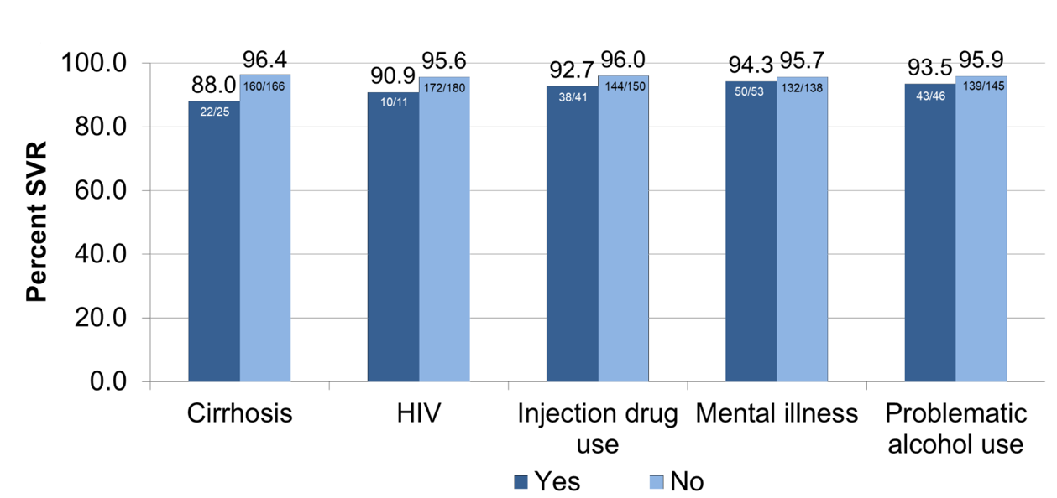
Figure 1(A). Proportion SVR by select co-morbidities
Notes: No comparisons were statistically significant. Cirrhosis, injection drug use, mental illness and problematic alcohol use were identified using physician and hospitalization diagnostic codes.

Slide 20
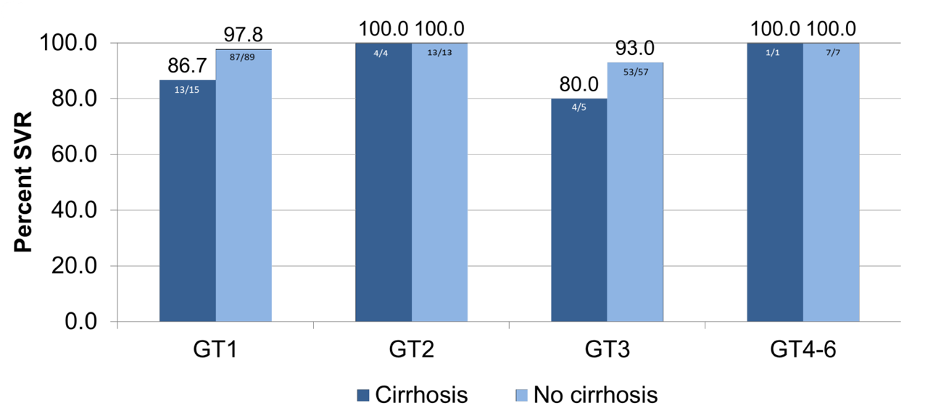
Figure 1(B). Proportion SVR by cirrhotic state and genotype
Notes: No comparisons were statistically significant. Cirrhosis, injection drug use, mental illness and problematic alcohol use were identified using physician and hospitalization diagnostic codes.

Slide 21
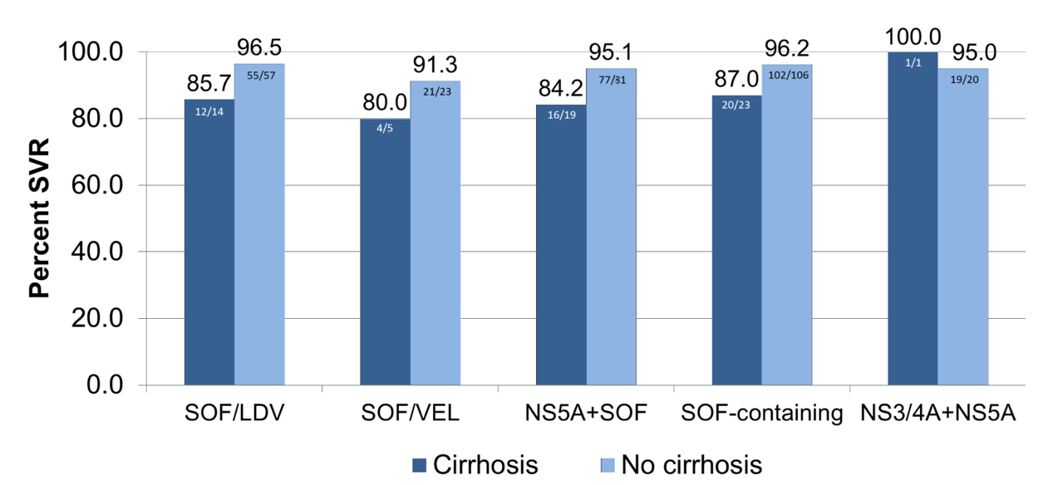
Figure 1(C). Proportion SVR previous treatment experience
Notes: No comparisons were statistically significant. Cirrhosis, injection drug use, mental illness and problematic alcohol use were identified using physician and hospitalization diagnostic codes.

Slide 22
Conclusions
In this real-world cohort evaluating SOF/VEL/VOX salvage treatment, SVR was higher than 91% across all genotypes.
Similar to the small number of other real-world studies (Table 1), a lower (but non-statistically significant) SVR was observed for cirrhosis, GT3 infection and prior SOF/VEL experience.

Slide 23
Conclusions
Table 1. Results from other real-world studies of SOF/VEL/VOX effectiveness
Limitations
Small sample size limited statistical power and precluded multivariable analysis.
No information on resistance-associated substitutions.

Slide 24
Pangenotypic Therapies glecaprevir-pibrentasvir (GLE-PIB) and sofosbuvir-velpatasvir-voxilaprevir (SOF-VEL-VOX) after failure with interferon (IFN)-free direct-acting antiviral (DAA) treatment for hepatitis C
¹Steven L Flamm, ²Naoky C Tsai, ³Bruce R Bacon, ⁴Michael P. Curry, ⁵Scott Milligan, ⁵Nicole Wick, ⁶Zobair M Younossi, ⁴Nezam H Afdhal
¹Division of Hepatology, Northwestern University, Feinberg School of Medicine, Chicago, IL, USA, ²University of Hawaii, Honolulu, Hawaii, USA, ³Saint Louis University School of Medicine, St. Louis, Missouri, USA, ⁴Beth Israel Deaconess Medical Center, Boston, MA, USA, ⁵Trio Health Analytics, La Jolla, CA, USA, ⁶Center for Liver Diseases and Department of Medicine, Inova Fairfax Hospital, Falls Church, VA, USA

Slide 25
Background And Aim
Despite the remarkable effectiveness of IFN-free DAA treatment in real-world HCV care, treatment failures remain a challenge in disease eradication.
Here, we examine outcomes with GLE-PIB or SOF-VEL-VOX after DAA failure/relapse.

Slide 26
Methods
Inclusion: patients who failed or relapsed following IFN-free DAA therapy and were subsequently treated with GLE-PIB (n=55) or SOF-VEL-VOX (n=176) between Jul 2017 and Dec 2018 [FIGURE 1]. Data were collected electronically from providers and specialty pharmacies through Trio Health’s disease management program. Variable comparisons were via chi-square or Exact tests with subsequent z-tests for column proportions. Bonferroni correction was applied for repeated measures. Significantly different variables were used in a logistic regression to generate propensity scores for 1-1 matching without replacement with GLE-PIB as the test group. Therapy duration was not included in matching due to sample limitations. eGFR was calculated by CKD-Epi equation.
Abbreviations: DCV = daclatasvir; SOF = sofosbuvir; EBR-GZR = elbasvir-grazoprevir; LDV = ledipasvir; PrOD = paritaprevir-ritonavir-ombitasvir + dasabuvir; SMV = simeprevir; RBV = ribavirin; VEL = velpatasvir; PP = Per Protocol; ITT = Intent to Treat; GT = genotype; HTN = hypertension; HCC = hepatocellular carcinoma; HLD = hyperlipidemia; PPI = proton pump inhibitor; CKD = Chronic Kidney Disease.

Slide 27
Figure 1: Selection Of Study Population

Slide 28
Results
In comparison to SOF-VEL-VOX, the GLE-PIB group had a higher percentage of baseline eGFR <30 ml/min (8% v. 1%, p=0.015), GT2 HCV (9% v 2%, p=0.040), hypertension (60% v. 42%, p=0.016), and care at academic centers (42% v. 26%, p=0.021) [TABLE 1].
GLE-PIB and SOF-VEL-VOX treatment groups were not significantly different for age, gender, insurance, ribavirin, anxiety, depression, diabetes, HCC, HIV, or HBV and had characteristics of GT1 (82% GLE-PIB v. 78% SOF-VEL-VOX, p=0.589) and baseline FIB4 >3.25 (37% GLE-PIB v. 38% SOF-VEL-VOX, p=0.651).
Therapy duration for GLE-PIB was 16 weeks (69%), 12 weeks (16%), and 8 weeks (15%); for SOF-VEL-VOX, 99% patients received 12 weeks (p<0.001).
Prior therapy was mostly LDV-SOF for both GLE-PIB (64%) and SOF-VEL-VOX (58%).

Slide 29
Results
SVR rates were significantly lower for GLE-PIB compared to SOF-VEL-VOX for both intent to treat (ITT, 84% v. 94%, p=0.017) and per protocol (PP, 85% v. 98%, p<0.001) populations [TABLE 2].
After propensity score matching, treatment groups (n=39 pairs) significantly differed only by therapy duration (GLE-PIB 69% 16 weeks, 15% 12 weeks, 15% 8 weeks v. SOF-VEL-VOX 100% 12 weeks, p<0.001) and had the following characteristics: 95% GT1, 5% GT 3, 100% eGFR>30 ml/min, 33% (GLE-PIB) to 36% (SOF-VEL-VOX) FIB4 >3.25, and prior therapy predominantly LDV-SOF (80%) [TABLE 1].
In the matched sample, SVR rates were significantly lower for GLE-PIB compared to SOF-VEL-VOX for ITT (85% v. 97%, p=0.048) and PP (85% v. 100%, p=0.012) [TABLE 3].
Overall, failure to achieve SVR with SOF-VEL-VOX in the ITT population was due to discontinuation (4/10), LTFU (1/10), death (2/10), and virologic failure (3/10) [TABLE 4]. In the ITT population receiving GLE-PIB, failure to achieve SVR was due to virologic failure (8/9) and treatment discontinuation (1/9) [TABLE 5].

Slide 30
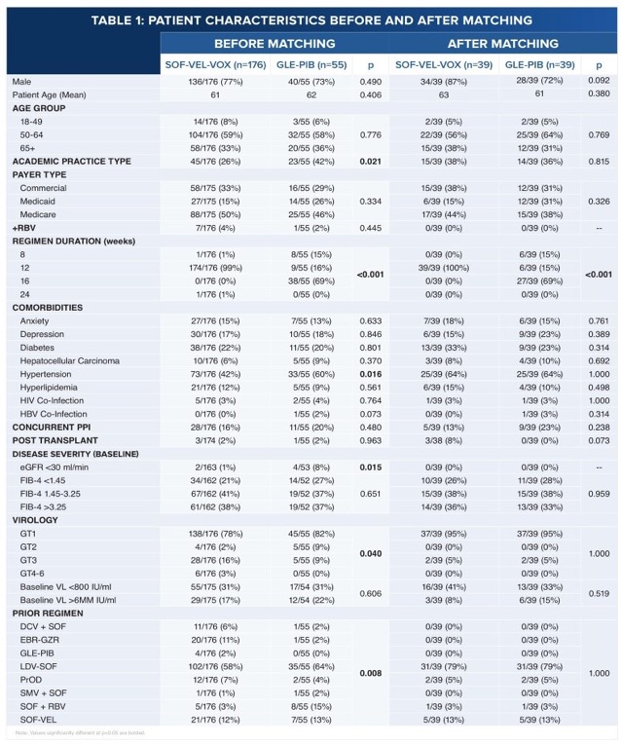
continua

Slide 31
segue

Slide 32
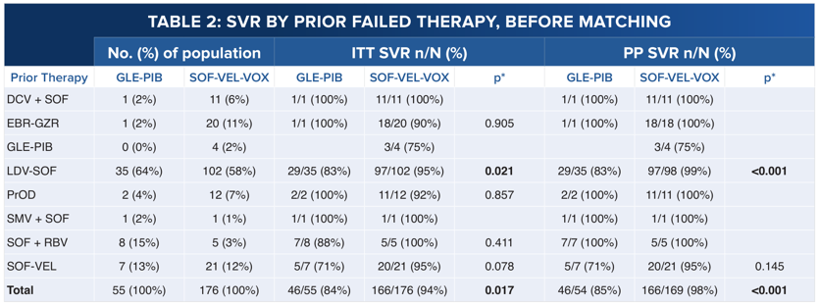

Slide 35
Conclusions
In HCV-infected patients with prior DAA failure/relapse, significantly higher ITT and PP SVR rates were observed with SOF-VEL-VOX compared to GLE-PIB both before and after adjustment for clinical differences.

