Slide 1
HBV

Slide 2
Differential Tenofovir Alafenamide (TAF) adoption in HBV-infected Populations –Assessment of care in US Clinical practice
Michael Curry¹, Ho Bae², Douglas Dieterich³, Victor Ankoma-Sey⁴, K. Rajender Reddy⁵, Calvin Pan⁶, Hie-Won Hann⁷, Myron Tong⁸, W. Ray Kim⁹, Paul Kwo⁹, Lynn Frazier¹⁰, Kimmi Cox¹¹, Scott Milligan¹¹, Nezam Afdhal¹
¹Beth Israel Deaconess Medical Center, Boston, MA, ²St. Vincent Medical Center, Asian Pacific Liver Center, Los Angeles, CA, ³Mount Sinai School of Medicine, New York, NY, ⁴Liver Associates of Texas, P.A., Houston, TX, ⁵University of Pennsylvania, Philadelphia, PA, ⁶NYU Langone Health, NYU School of Medicine, New York, NY$x^{2}$, ⁷Thomas Jefferson University Hospital, Philadelphia, PA, ⁸Huntington Medical Research Institute Liver Center, Pasadena, CA, ⁹Stanford University School of Medicine, Stanford, CA, ¹⁰Liver Wellness Center, Little Rock, AR, ¹¹Trio Health Analytics, La Jolla, CA

Slide 3
Background and aims
Previously we reported increased HBV suppression, ALT normalization, and improved renal function with TAF treatment.
However, certain patients that would potentially benefit from switching to TAF, e.g. with impaired renal function, remained on non-TAF therapies.
Here we further examined variables associated with TAF adoption from approval (Nov 2016) to Dec 2018.

Slide 4
Methods
Patients enrolled in the TRIO HBV registry from 6 academic and 4 community centers in the US and followed through Dec 2018 were included in this study (n=1037).
Elevated ALT was defined as >35 U/L for males and >25 U/L for females, HBV suppression was assigned for HBV DNA measures ≤2000 IU/ml.
Comparisons between baseline and TAF adoption by 24 months measures were made using McNemar’s test (for dichotomous variables), Bowker’s test (for multi-level variables) or t-test (for continuous variables).
TAF initiation was assessed using Kaplan-Meier methods with subsequent log-rank tests.
Overall TAF initiation rates were compared using z-tests.

Slide 5
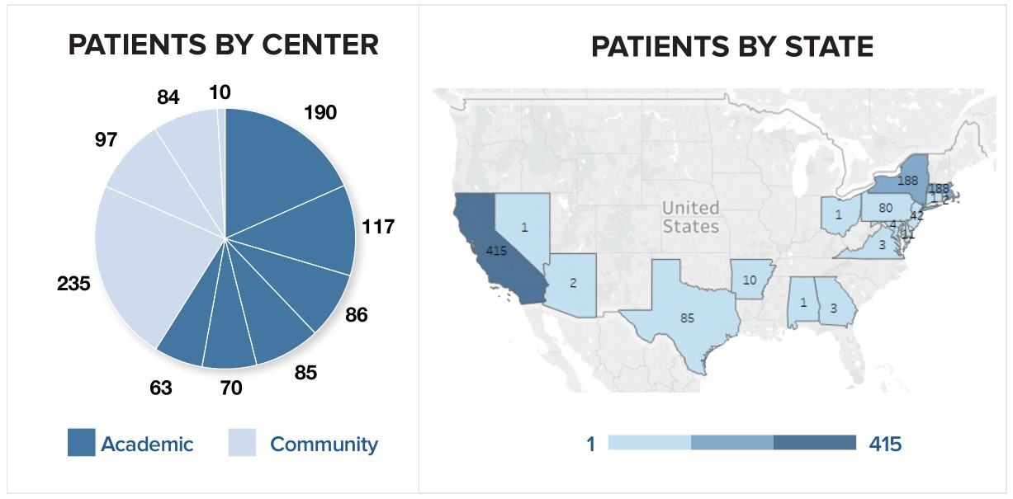

Slide 6
Results
The study population (n=1037) was predominantly male (599, 58%), Asian (887, 86%), <60 years old (700, 68%), from academic centers (611, 59%), with HBV DNA suppression (951/1035, 92%) [TABLE 1].
396 (38%) patients initiated TAF [TABLE 2]. Adoption was significantly higher in patients receiving TDF at enrollment (52% v. 12% non-TDF, p<0.001) and at community practices (56% v. 25% academic, p<0.001) [FIGURE 2].
Adoption was also higher in patients without HCC history (39% v. 8%, p=0.005), fatty liver (39% v. 8%, p<0.001), or hyperlipidemia (39% v.
28%, p=0.005) [TABLE 1]. Adoption was not significantly different by age, insurance type, osteopenia/osteoporosis, HBV DNA, eGFR, FIB-4, or ALT [TABLE 1 and FIGURE 2].
Reasons for initiating TAF were provided for 365/396 patients: 66% (241/365) indicated safety/side effects, 27% (99/365) physician preference, and 6% (21/365) efficacy [FIGURE 1].

Slide 7
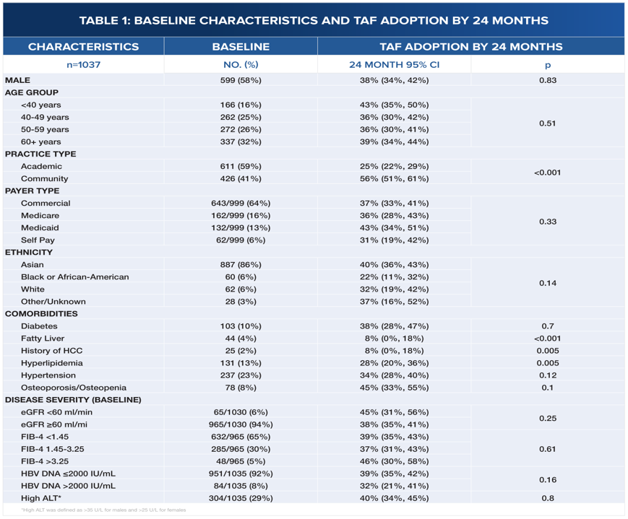

Slide 9
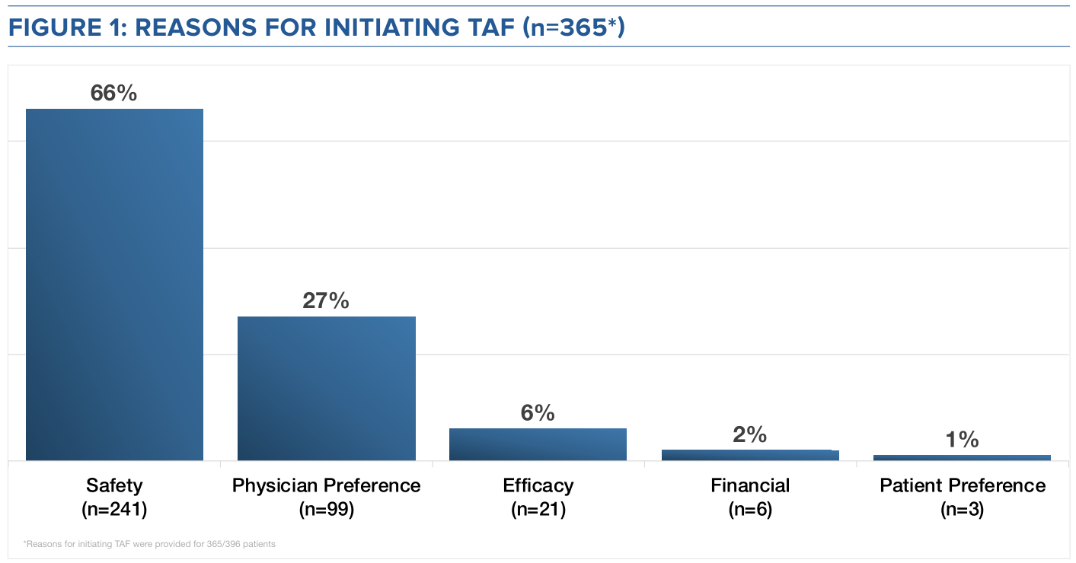

Slide 10
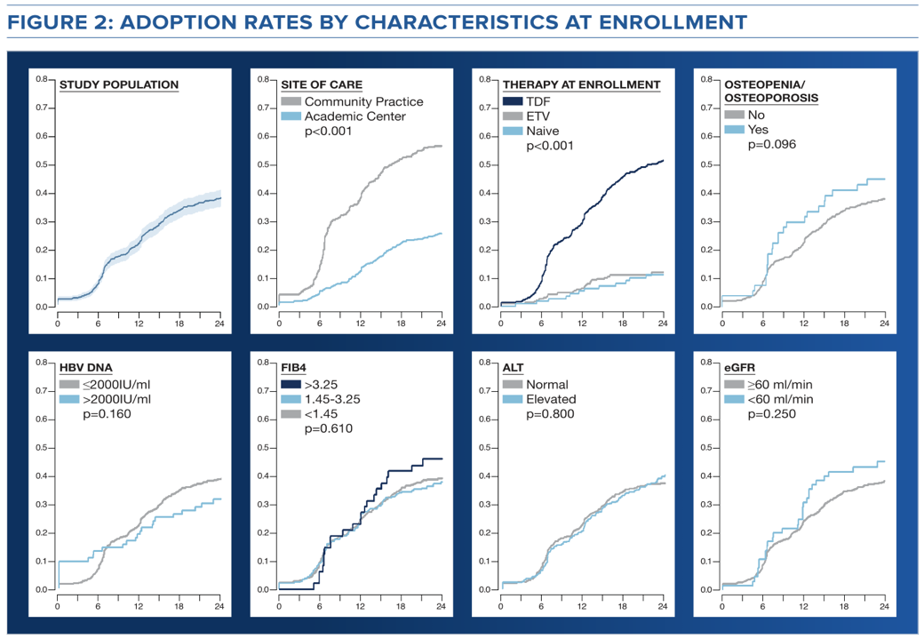

Slide 11
Tenofovir Alafenamide is effective and safe for chronic hepatitis B patients with Advanced fibrosis and partial virologic responses to prior oral nucleos(t)ide analogues – An Interim report of "ESTAB-AFPVR"
Ming-Lun Yeh¹, Chi-Yi Chen², Pin-Nan Cheng³, Ming-Jong Bair⁴, Jyh-Jou Chen⁵, Ching-Chu Lo⁶, Chi-Ming Tai⁷, Ching-Yang Tsai⁸, Kuo-Chih Tseng⁹, Chien-Hung Chen¹⁰, Chao-Hung Hung¹¹, Jee-Fu Huang¹, Chia-Yen Dai¹, Wan-Long Chuang¹, Ming-Lung Yu¹
¹ Hepatitis Center and Hepatobiliary Division, Department of Internal Medicine, Kaohsiung Medical University Hospital, Kaohsiung, Taiwan. ² Division of Gastroenterology and Hepatology, Ditmanson Medical Foundation Chia-Yi Christian Hospital, Chia-Yi, Taiwan. ³ Division of Gastroenterology and Hepatology, National Cheng Kung University Hospital, Tainan, Taiwan, ⁴ Division of Gastroenterology and Hepatology, Taitung MacKay Memorial Hospital, Taitung, Taiwan. ⁵ Division of Gastroenterology and Hepatology, Chi Mei Medical Center, Liouying, Taiwan. ⁶ Division of Gastroenterology and Hepatology, St. Martin De Porres Hospital, Chia-Yi, Taiwan. ⁷ Division of Gastroenterology and Hepatology, E-Da Hospital, Kaohsiung, Taiwan. ⁸ Division of Gastroenterology and Hepatology, Yuan’s General Hospital, Kaohsiung, Taiwan. ⁹ Division of Gastroenterology and Hepatology, Dalin Tzu Chi Hospital, Chia-Yi, Taiwan. ¹⁰ Division of Gastroenterology and Hepatology, Kaohsiung Chang Gung Memorial Hospital, Kaohsiung, Taiwan. ¹¹ Division of Gastroenterology and Hepatology, Chiayi Chang Gung Memorial Hospital, Chia-Yi, Taiwan.

Slide 12
Introduction
Although with high potency in viral suppression1, there were remained patients who demonstrated partial or suboptimal response to entecavir (ETV) or tenofovir disoproxil fumarate (TDF).
For those with remained detectable HBV DNA after one, even 2 years of NUC therapy (persistent low-level viremia), there were still insufficient data regarding add-on second drug, or changing to another drug, or continuation of prior monotherapy.2,3
In the phase 3 trials4,5, tenofovir alafenamide (TAF) had demonstrated a similar effect of viral suppression, and a higher rate of alanine aminotransferase (ALT) normalization to TDF.
Improved renal function and less bone loss were also identified with TAF therapy.

Slide 13
Aim
We aimed to investigate the effect and safety of TAF switching in chronic hepatitis B (CHB) patients with advanced fibrosis and partial response to other nucleot(s)ide analogues (NUCs).

Slide 14
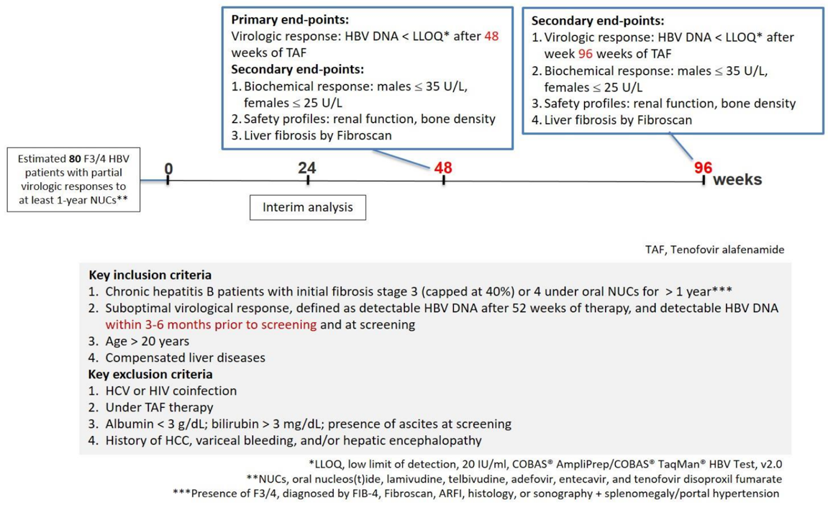
Method
Study Design, Inclusion and Exclusion criteria

Slide 15
Method
Primary endpoint: Rate of virological response (HBV DNA<LLOQ) after 48 weeks of TAF therapy.
Secondary endpoints:
Rate of virological response (HBV DNA <LLOQ) after 96 weeks of treatment.
Rate of ALT normalization by local (<40 U/L), and AASLD (male ≤35, female ≤25 U/L) criteria at week 48 and 96.
Changes of serum creatinine, calculated creatinine clearance and renal tubular function from baseline to week 48 and 96.
Changes in bone mineral density from baseline to week 48 and 96.
Changes in liver fibrosis from baseline to week 48 and 96 determined by Fibroscan.
Prespecified factors associated with virological responses and/or ALT normalization 48 and 96 weeks after switching to TAF.

Slide 16
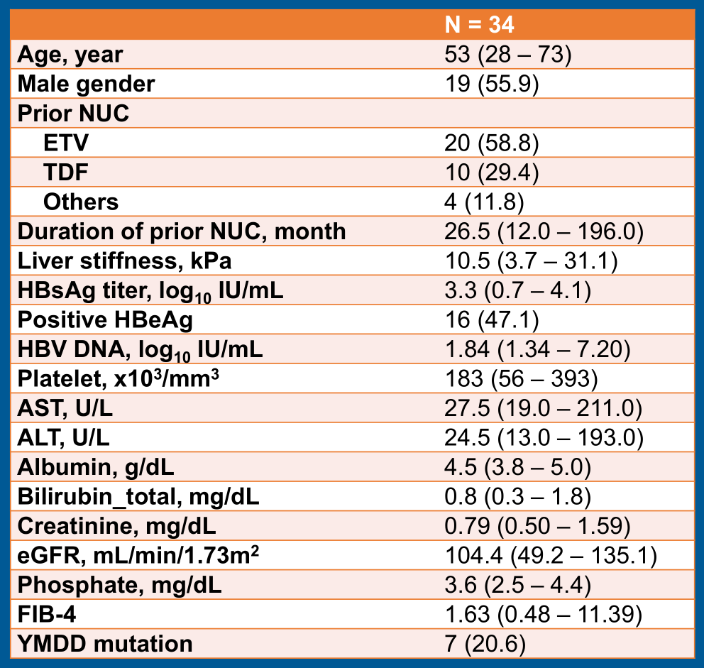

Slide 17
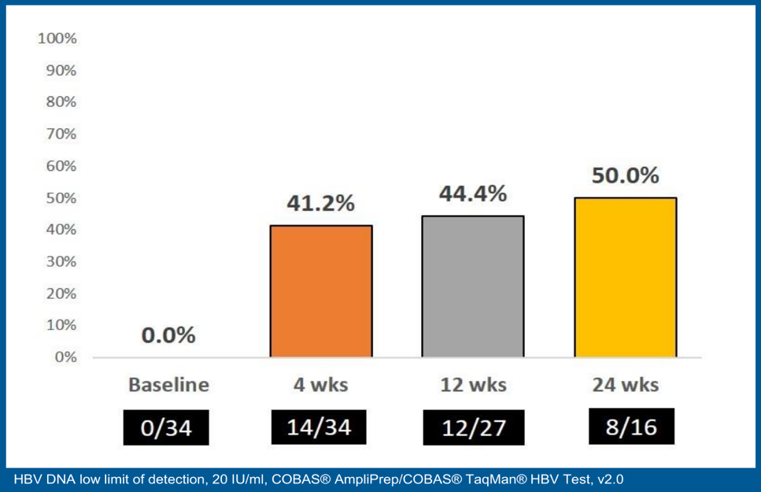

Slide 18
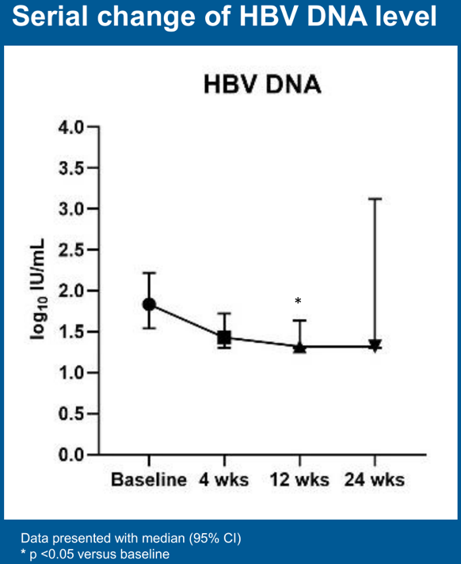

Slide 19
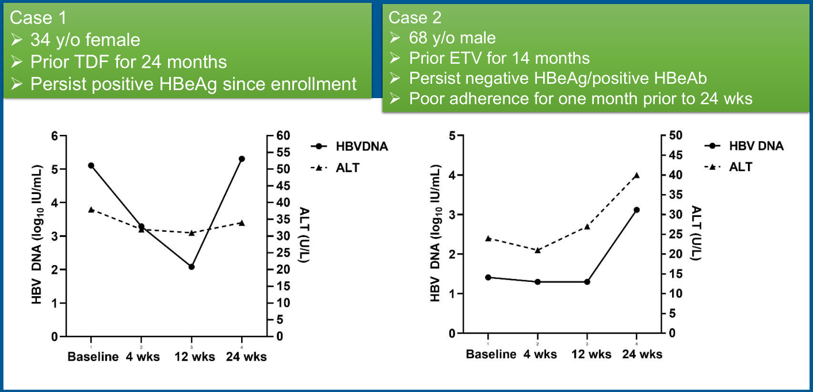

Slide 20
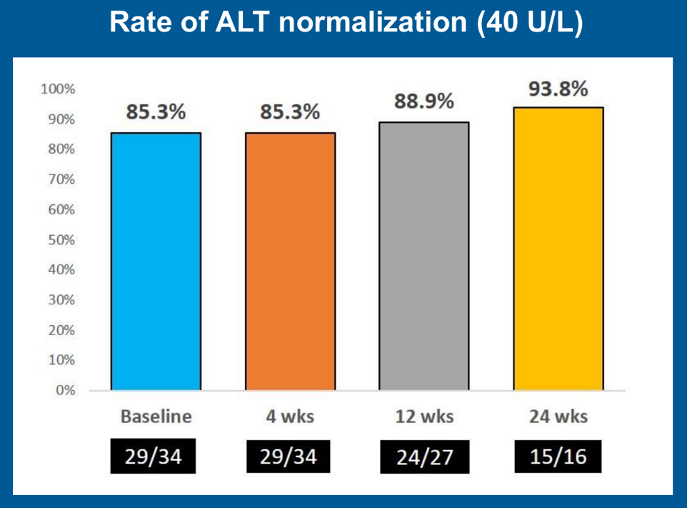

Slide 21
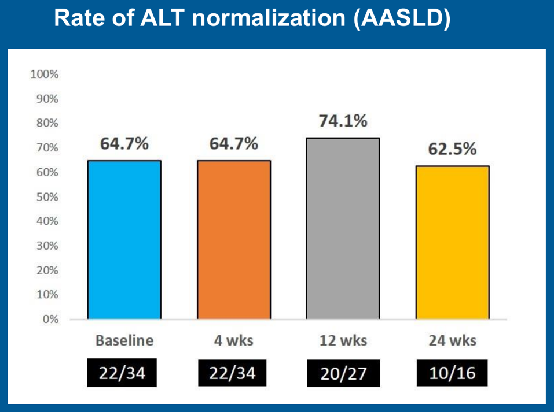

Slide 23
Conclusions
The preliminary results demonstrated the efficacy and safety of TAF switching in viral suppression for those patients with advanced fibrosis and partial virologic responses to other NUCs.

